Slide 1
9-2018-3
Výukový materiál pro 9.ročník
Autor materiálu: Mgr. Martin Holý
Další šíření materiálu je možné pouze se souhlasem autora

Slide 2
9-2018-3
13,5
1,5
4,5 . 3 =
4,5 : 3 =
.10
13,5 : 1,5 =
135 : 15 =
9x
3
35
40
+ 30
– 35
.10
$$\frac{0,09}{0,1}:0,01=$$
$$\frac{0,9}{1}:0,01=$$
.100
$$0,9 :0,01=$$
$$90 :1=$$
$$90$$

Slide 3
9-2018-3
$$\frac{7}{12}−\frac{5}{8}.\frac{8}{5}=$$
$$\frac{7}{12}−1=$$
$$\frac{7−12}{12}=$$
$$−\frac{5}{12}$$
$$16$$
$$\frac{\frac{8}{3}−\frac{8}{5}}{\frac{8}{3}}=$$
$$\frac{\frac{40−24}{15}}{\frac{8}{3}}=$$
2
1
$$\frac{16}{15}.\frac{3}{8}=$$
$$\frac{2}{5}$$
5
1

Slide 4
9-2018-3
9a² + 6a + 1
– 6a – 15a² =
-6a² + 1
$\frac{b}{2}+$b²
– 1 + $\frac{b}{2}$ =
b² + b – 1
/ .18
$x$= 0
15 – 15x = 20x - 6
/ -20x-15
-35x = -21
/ :(-35)
x = $\frac{−21}{−35}$ = $\frac{3}{5}$

Slide 5
9-2018-3
$n+\frac{3}{4}n+n$ + 140 = 3n
560 Kč
Nela … n
$n+\frac{3}{4}n+n$ + 140 = 3n
/ .4
Olga … $n−\frac{1}{4}n=$
$\frac{3}{4}n$
4n + 3n + 4n + 560 = 12n
11n + 560 = 12n
/ -12n-15
Pavla … n + 140
-n = -560
/ .(-1)
n = 560

Slide 6
9-2018-3
2,4 m² = 240 dm²
240 dm² - 50 dm² = 190 dm²
2,4 t = 2 400 kg
2400 : 50 = 48x
7⁰ = 420‘
420 : 35 = 12x

Slide 7
9-2018-3
3
$$\sqrt{13}$$
x
5
S = a . v
S = 5 . 3
S = 15 cm²
x² = ${\sqrt{13}}^{2}$- 3²
x² = 13 - 9
|AB| = 2 + 5 = 7 cm
x = $\sqrt{4}$
x = 2 cm

Slide 8
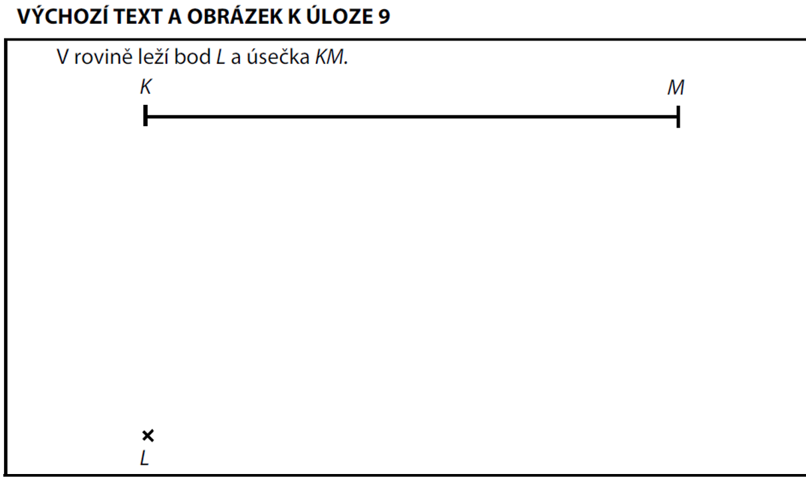
9-2018-3
P

Slide 9
9-2018-3
C

Slide 10
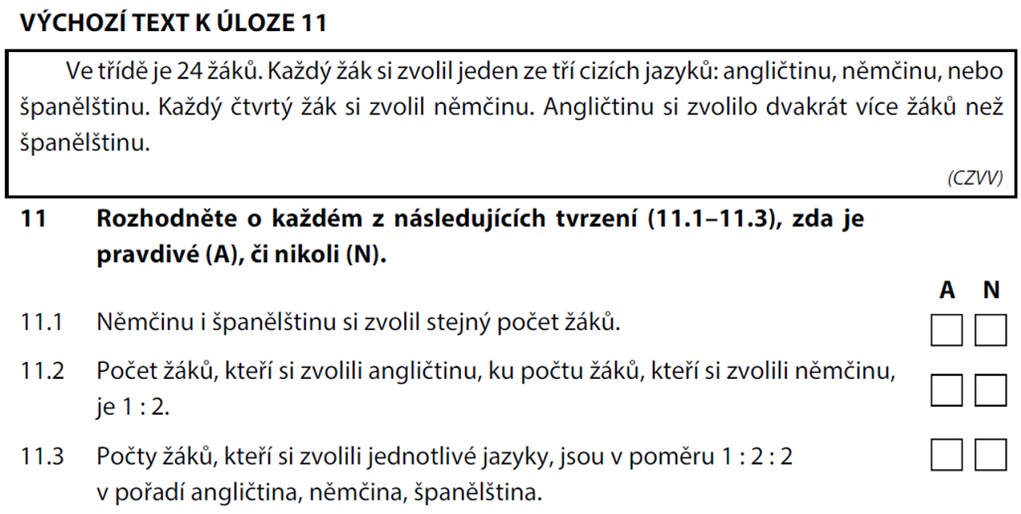
9-2018-3
6 = 6
Aj : Nj = 12 : 6 = 2 : 1
Aj : Nj : Šj = 12 : 6 : 6 = 2 : 1 : 1
Nj … 6
Šj … s
6 + s + 2s = 24
/ -6
… 6
… 12
3s = 18
/ :3
Aj … 2s
s = 6

Slide 11
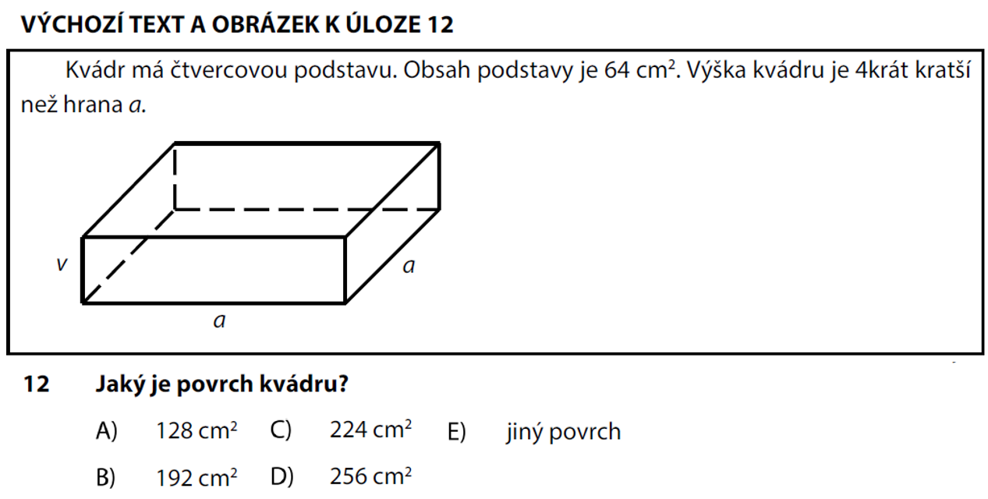
9-2018-3
S = a² = 64 cm²
a = $\sqrt{64}$
a = 8 cm
c =
= b
= 8 cm
v = 8 : 4
= 2 cm
= 8 cm
v = 2 cm
S = 2.(a.b + a.c + b.c)
S = 2.(8.8 + 2.8 + 2.8)
S = 2.96
S = 192 cm²

Slide 12
9-2018-3
β = (180⁰ - 80⁰) : 2
β = 50⁰
β⁰
α = 80⁰ + 50⁰
α = 130⁰

Slide 13
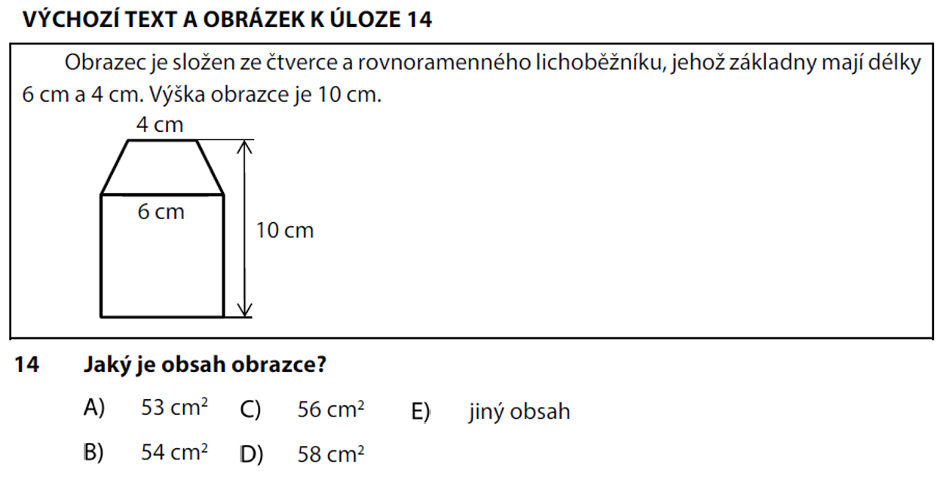
9-2018-3
S□ = a . a
S = S□ + S
4 cm
S□ = 6 . 6
S = 36 + 20
S = 56 cm²
S□ = 36 cm²
6 cm
S = $\frac{\left(a + c\right) . v}{2}$
S = $\frac{\left(6 + 4\right) . 4}{2}$
S = 20 cm²

Slide 14
9-2018-3
A
E
D
100% = 15 Kč
25% = 10
150% = 42 min
140% = 21 Kč
100% = 40
100% = 28 min
nebo
100% = 28 min
$15+ \frac{2}{5}.15=21$Kč
125% = 35 min

Slide 15
9-2018-3
2 věže = 3 bílé + 6 šedých
2 věže = 9 kostek
12 : 2 = 6
6 . 3 = 18
6 . 6 = 36
180 : 9 = 20 „dvojvěží“
2 . 20 = 40 věží

Slide 16
9-2018-3
Konec prezentace

