Slide 1
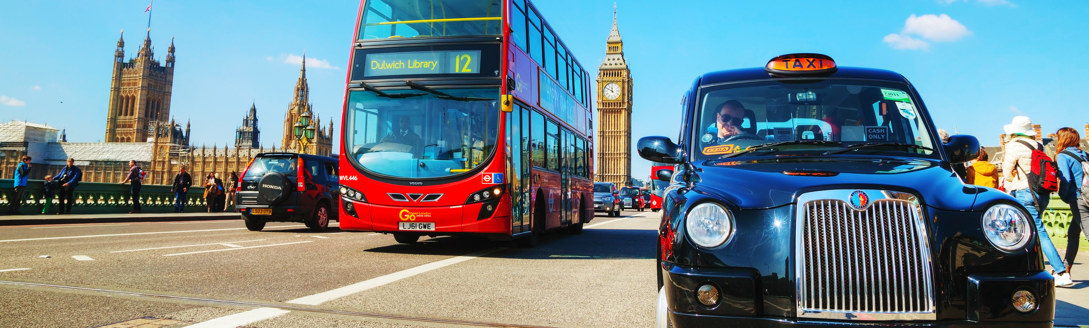
Transport in Britain
CULTURE

Slide 2
Lesson Plan
warm-up
SB - article
slideshow
speaking
homework

Slide 3
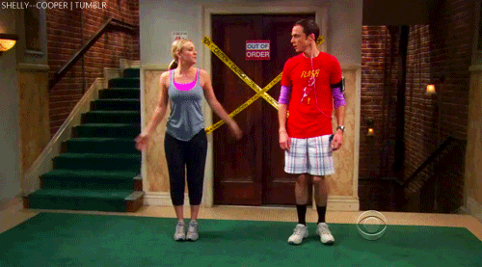
WARM-UP!
https://www.flippity.net/fc.php?k=1z63kMWGQGnkm-JcfFqaF3GquTkJiRWsHoIRk8IuYLCY

Slide 4
Name 10 …
EUROPEAN CAPITAL CITIES

Slide 5
TRANSPORT IN BRITAIN
STUDENT‘S BOOK
p. 28

Slide 6
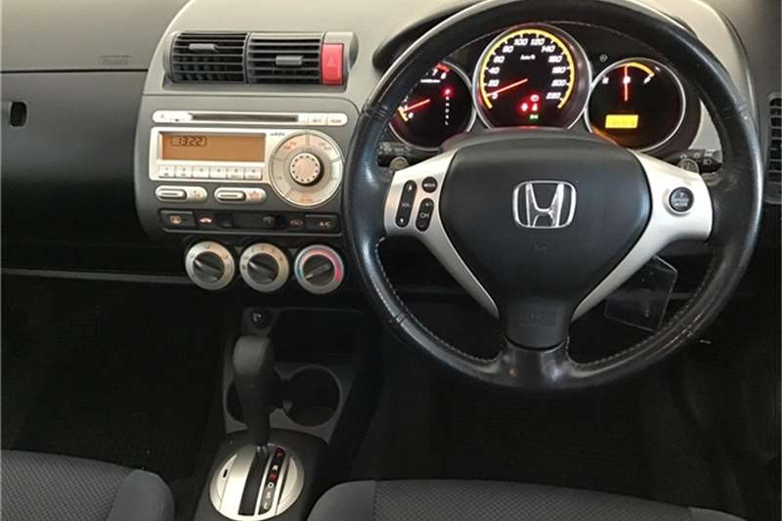
DRIVING ON THE RIGHT SIDE
Steering wheel
Vehicles
Motorway
Ring road
A toll

Slide 7
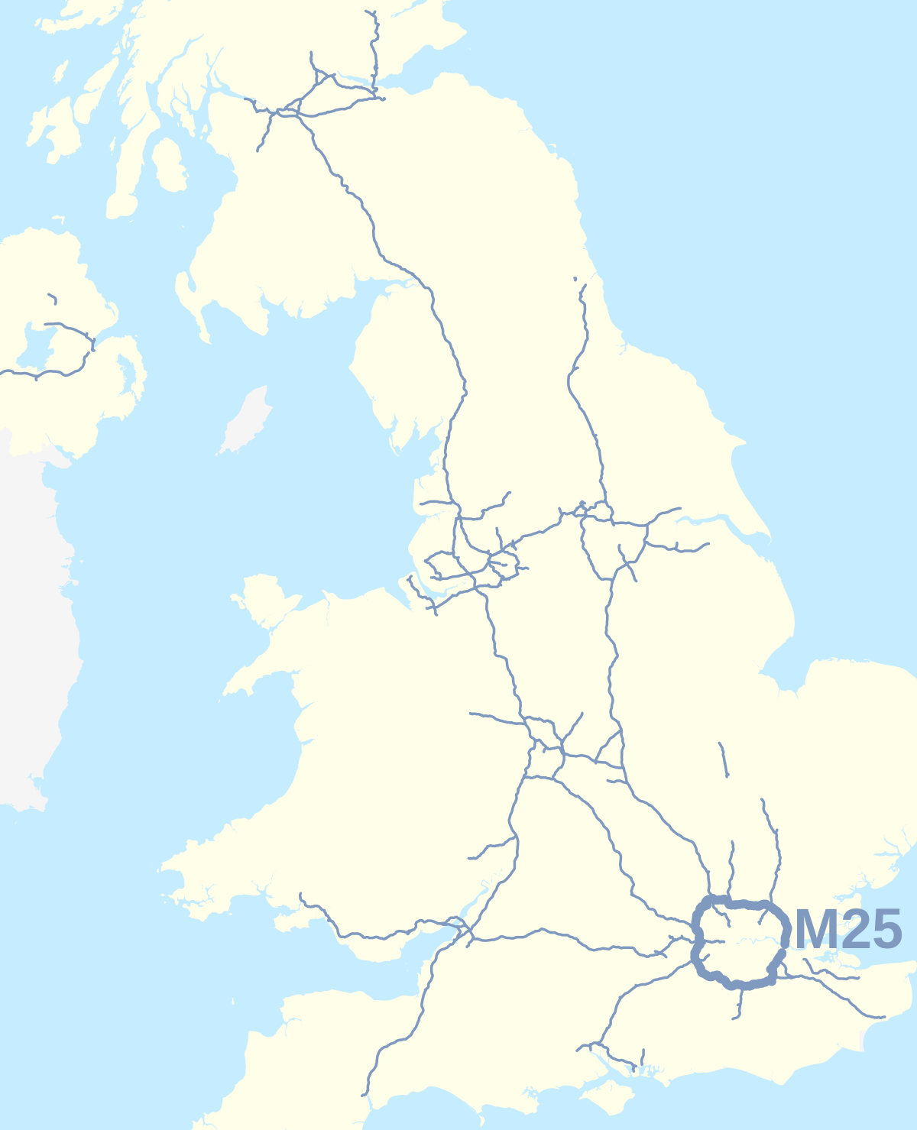
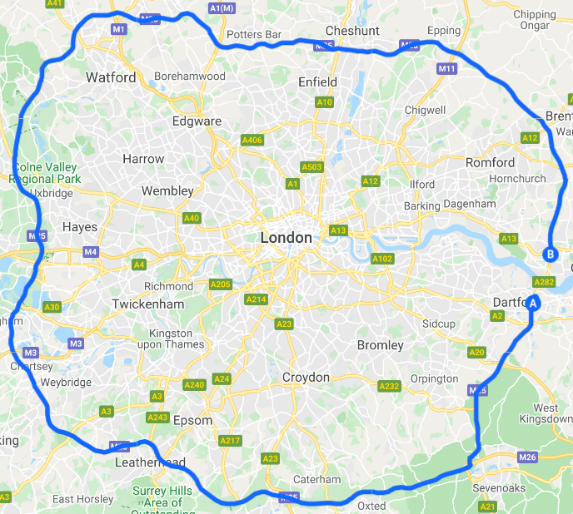
M25

Slide 8
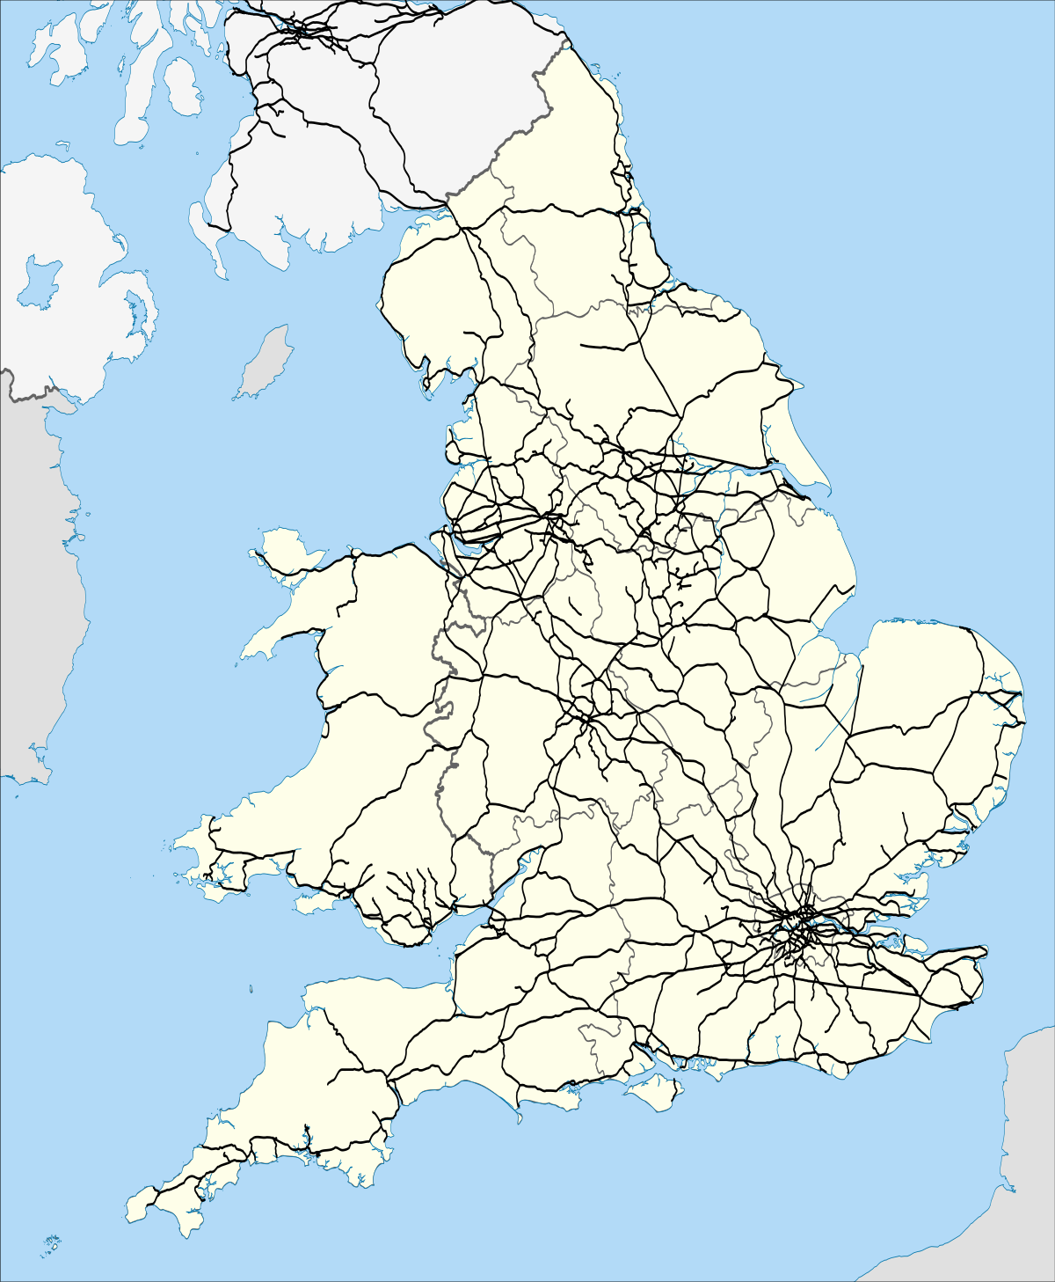
RAILWAYS

Slide 9
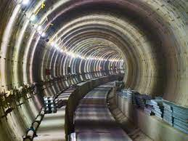
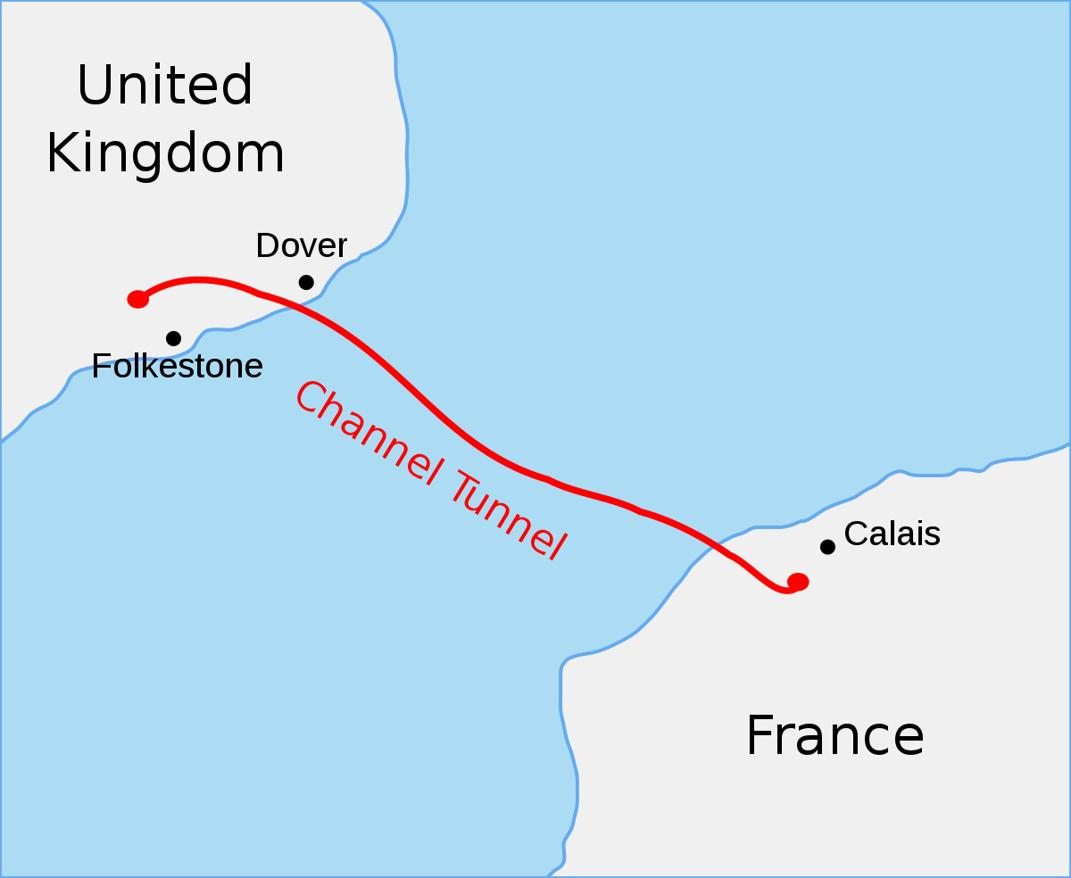
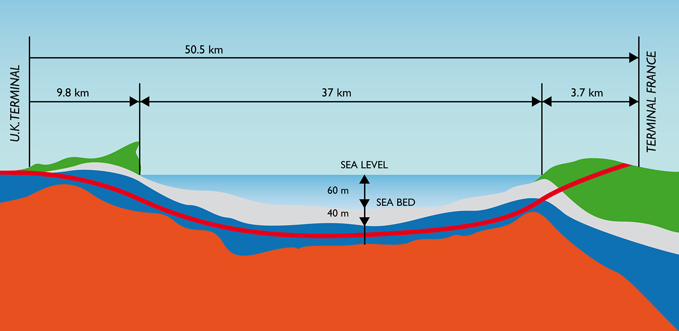
CHANNEL TUNNEL

Slide 10
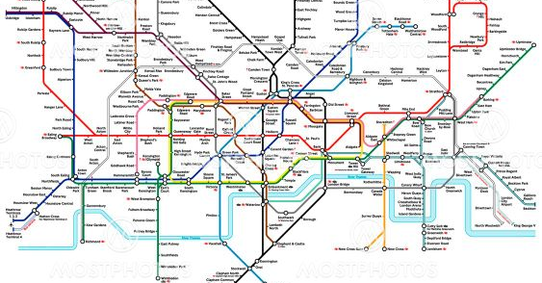
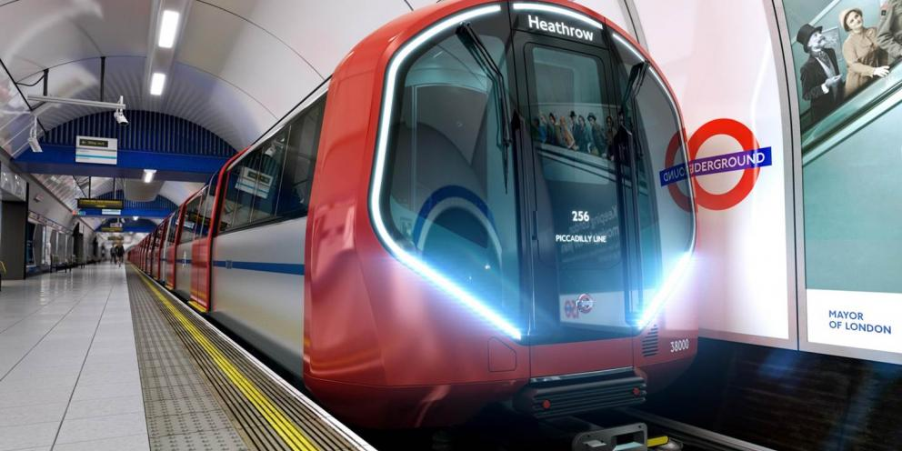
TRANSPORT IN LONDON

Slide 11
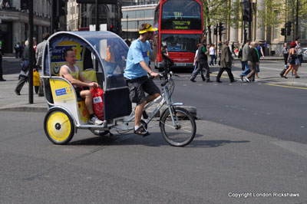
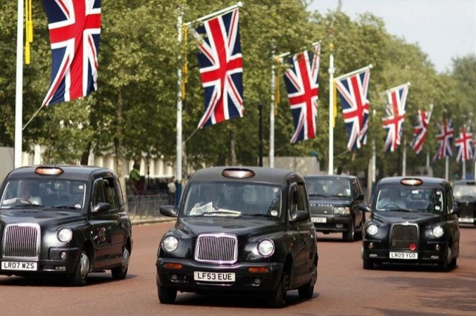
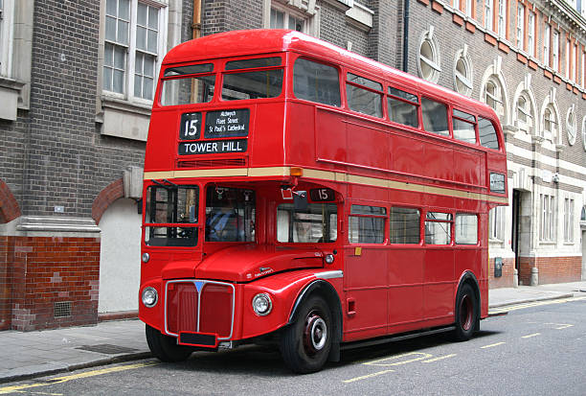
TRANSPORT IN LONDON

Slide 12
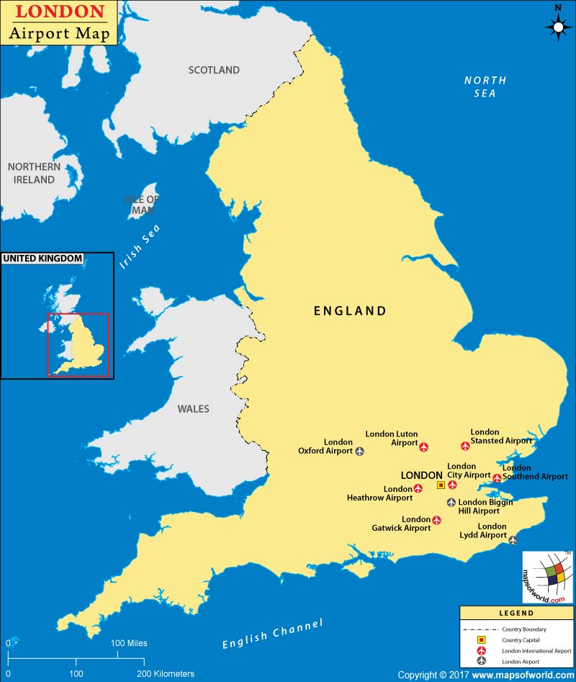
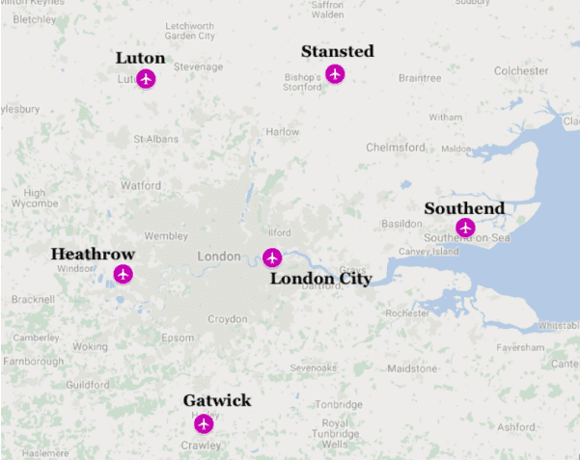
AIRPORTS

Slide 13
HOMEWORK
vocabulary 3A

Slide 14
Lesson Plan
warm-up
SB - article
slideshow
speaking
homework

