Slide 1
Revision
Unit 5

Slide 2
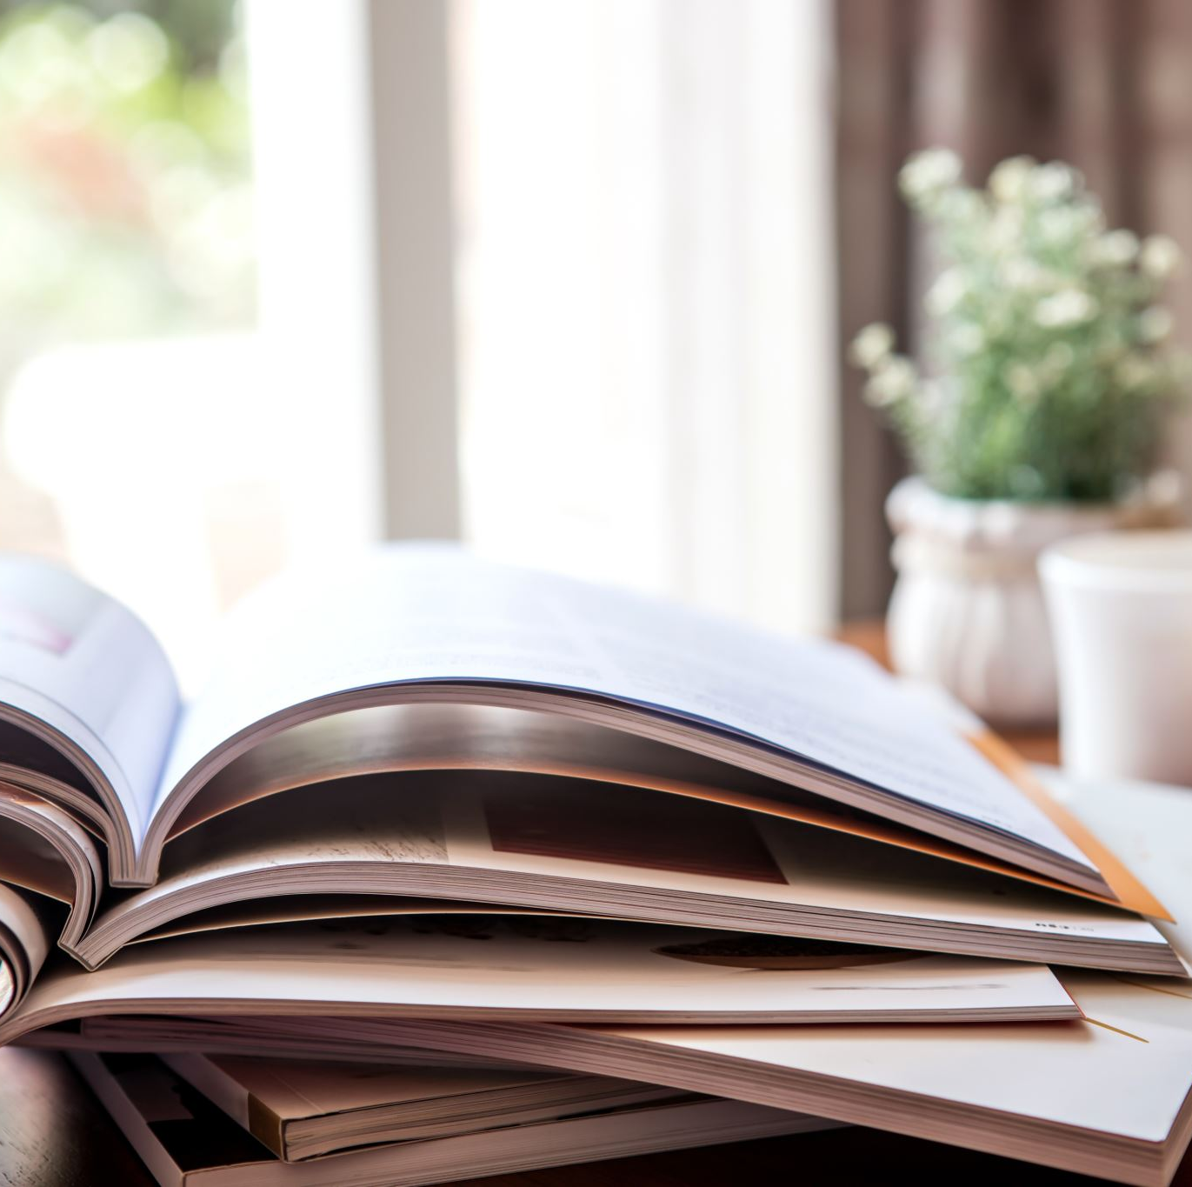
Lesson Plan
check your homework
warm-up
listening practice
present perfect – practice
vocabulary - practice
homework

Slide 3
CHECK YOUR HOMEWORK!
I‘VE JUST DROPPED MY CAMERA.
I‘VE JUST GOT UP.
I‘VE JUST CLEANED THE FLOOR.
I‘VE JUST CALLED HIM.
I‘VE JUST SENT HER AN E-MAIL.

Slide 4
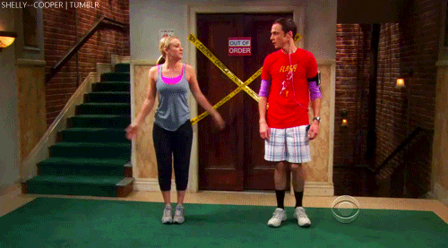
WARM-UP!
https://www.flippity.net/fc.php?k=1z63kMWGQGnkm-JcfFqaF3GquTkJiRWsHoIRk8IuYLCY

Slide 5
WARM-UP!
PLAVAT
STÁT SE
KRESLIT
BĚHAT
NASTAVIT

Slide 6
LISTENING PRACTICE
1 Listen and complete the sentences.
How long have they had a photography club at the school?
Why did they have to change the room?
What does Miss Dean teach?
What did Jack Parker take a photo of?
What did they use this photograph for?
Who will give some advice later on in the evening?
When will there be organized trips?
When will there be a competition?
They’ve had a photography club at school for five years.
They had to change the room because it was too small.
Miss Dean teaches Science.
He took a photo of the church in winter.
They used Jack’s photograph for a poster.
Jack Parker and Miss Dean will give some advice later on in the evening.
There will be organized trips at the weekend.
There’ll be a competition in June.

Slide 7
PRESENT PERFECT practice
2. Write complete sentences. Use the present perfect.
I / not read / my book
our class / not win / the sports prize
Milly / take / the dog / for a walk
they / not do / anything
Thomas / tidy / his room
we / make / a chocolate cake
Beth / not buy / any new clothes
the boys in my class / not do / their homework
I haven’t read my book.
Our class hasn’t won the sports prize.
Milly has taken the dog for a walk.
They haven’t done anything.
Thomas has tidied his room.
We’ve made a chocolate cake.
Beth hasn’t bought any new clothes.
The boys in my class haven’t done their homework.

Slide 8
PRESENT PERFECT practice
3. Rewrite the sentences using never.
1. She hasn’t been to Canada.
2. I haven’t seen an octopus.
3. Charlie hasn’t sung in the school choir.
4. Melanie and Lisa haven’t cooked spaghetti.
5. Mr Lewis hasn’t flown in a helicopter.
6. My little sister hasn’t fallen out of bed.
7. I haven’t planted a tree.
She has never been to Canada.
I have never seen an octopus.
Charlie has never sung in the school choir.
Melanie and Lisa have never cooked spaghetti.
Mr Lewis has never flown in a helicopter.
My little sister has never fallen out of bed.
I have never planted a tree.

Slide 9
PAST PARTICIPLE practice
INFINITIVE | PAST PARTICIPLE | INFINITIVE | PAST PARTICIPLE
RIDE |  | JUMP
DO |  | CHOOSE
GO |  | READ
EAT |  | ENJOY
CLIMB |  | COME
SWIM |  | SING
WRITE |  | PLAY
SINK |  | FRY
RIDDEN
JUMPED
DONE
CHOSEN
GONE
READ
EATEN
ENJOYED
CLIMBED
COME
SWUM
SUNG
3. Complete the sentences. Choose from these words.
WRITTEN
PLAYED
SUNK
FRIED

Slide 10
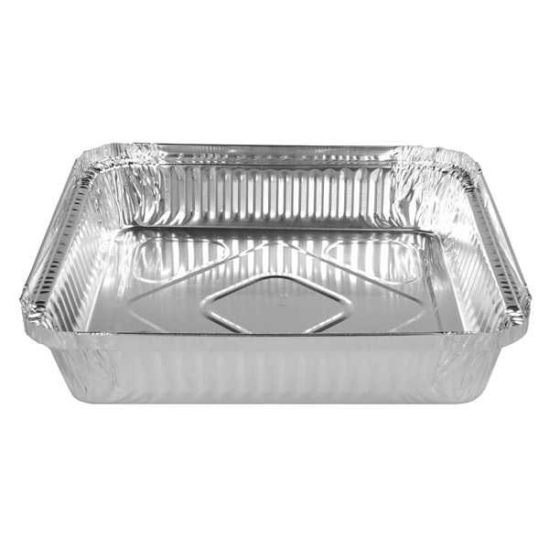
VOCABULARY
FOIL TRAY

Slide 11
VOCABULARY
CARDBOARD BOX

Slide 12
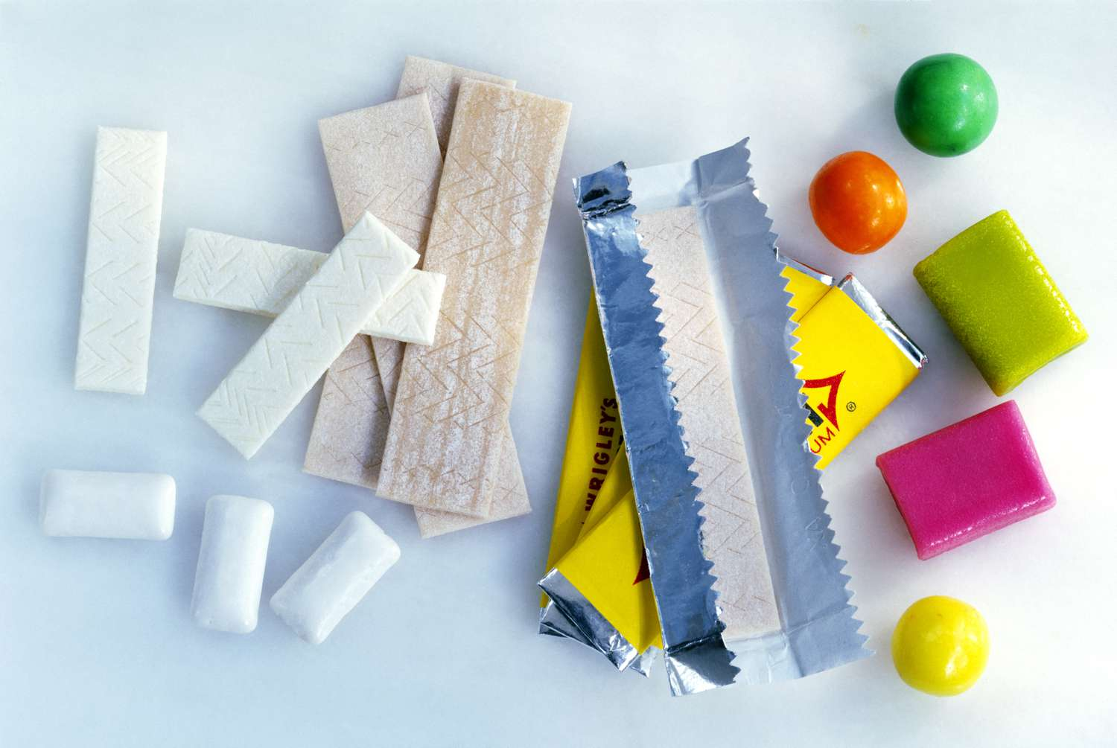
VOCABULARY
CHEWING GUM

Slide 13
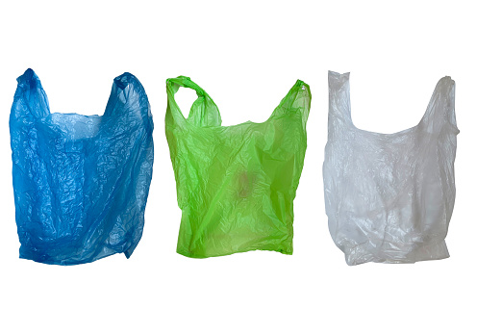
VOCABULARY
PLASTIC BAG

Slide 14
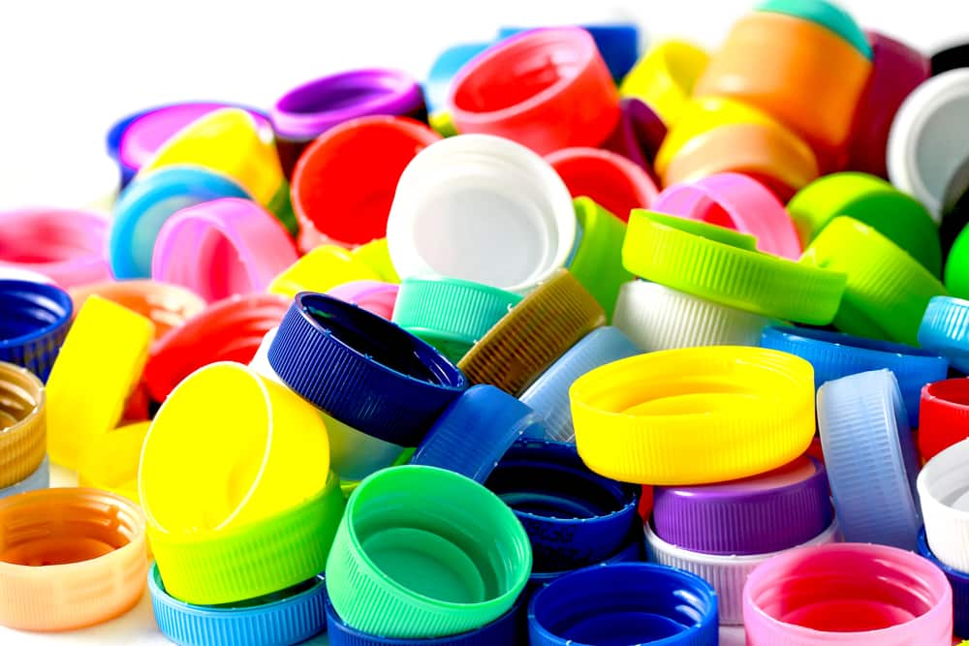
VOCABULARY
BOTTLE TOP

Slide 15
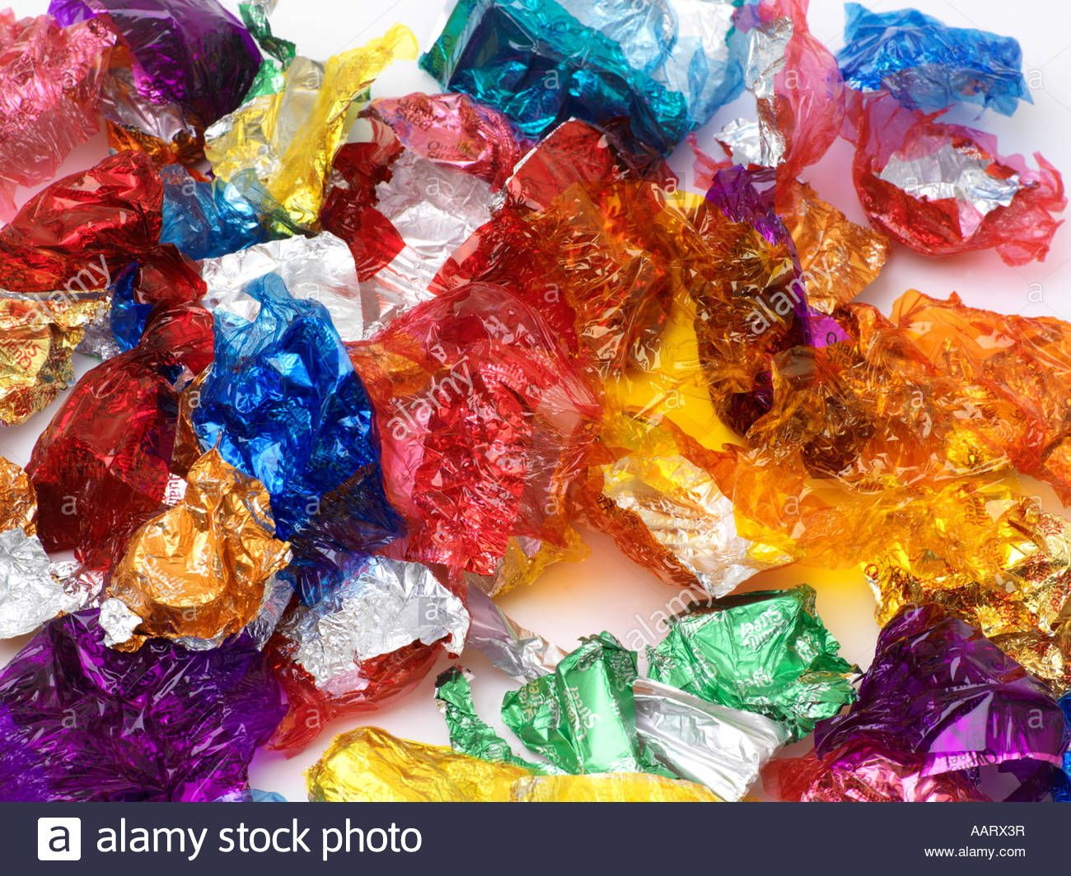
VOCABULARY
SWEET WRAPPERS

Slide 16
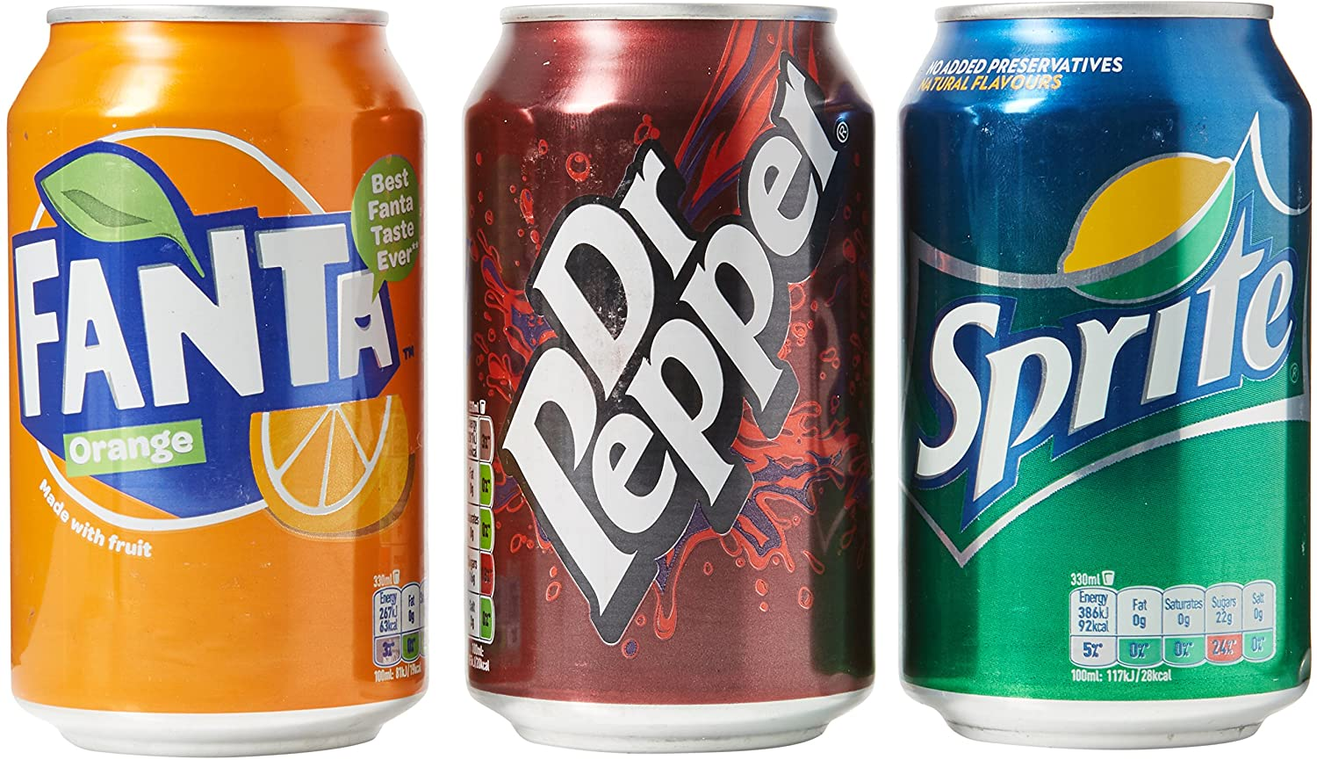
VOCABULARY
DRINKS CANS

Slide 17
PROJECT REMINDER
THE CZECH CELEBRITY

Slide 18
HOMEWORK
STUDY FOR THE TEST (MAY 12)
MAKE YOUR PROJECT (MAY 13)
IRREGULAR VERBS

Slide 19
Lesson Plan
check your homework
warm-up
listening practice
present perfect – practice
vocabulary - practice
homework

