Slide 1
Revision II
Unit 5

Slide 2
Lesson Plan
5 mins test
warm-up
reading – practice
present perfect – practice
vocabulary – practice
homework

Slide 3
5 mins test

Slide 4
5 mins test
CZECH | INFINITIVE | PAST SIMPLE | PAST PARTICIPLE
UČIT SE
 | GIVE
 |  | FELT
 |  |  | BOUGHT
BĚHAT

Slide 5
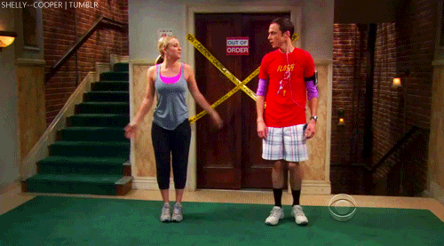
WARM-UP!
https://www.flippity.net/fc.php?k=1z63kMWGQGnkm-JcfFqaF3GquTkJiRWsHoIRk8IuYLCY

Slide 6
WARM-UP!
ZAPOMENOUT
LEPIT
ZAMETAT
PRODAT
SPÁLIT
VZBUDIT SE

Slide 7
READING PRACTICE
Read the text. Then correct the mistake in the sentences.
Why did James Eagle become famous in 2003?
What did the people have to do on the Sherkin Island?
What kind of TV programmes has James presented?
Which ocean did James row across with Will Turner?
How long did it take for James to ski to the North Pole?
What happened to James while he was working in Chile?
How many books has James written?
He took part in a reality programme.
They had to grow their food and build their houses.
James has presented nature and animal programmes.
James rowed across the Atlantic with Will Turner.
It took him 15 days to ski to the North Pole.
He became ill while he was working in Chile.
James has written four books.

Slide 8
PRESENT PERFECT - PRACTICE
2. Write complete sentences or questions with the present perfect. Put the word in brackets in the correct place.
your friends / fly / in a plane? (ever)
Michael / win / a competition. (never)
we / finish / our homework. (just)
Jake / play / tennis for the school. (never)
Lizzie / climb / a mountain? (ever)
Linda and Bridget / cook / dinner for their parents. (just)
they / be / in hospital? (ever)
George / sleep / in a caravan. (never)
Have your friends ever flown in a plane?
Michael has never won a competition.
We’ve just finished our homework.
Jake has never played tennis for the school.
Has Lizzie ever climbed a mountain?
Linda and Bridget have just cooked dinner for their parents.
Have they ever been in hospital?
George has never slept in a caravan.

Slide 9
PRESENT PERFECT - PRACTICE
3. Write complete questions.
you / ever / write / a letter
your dad / ever / cook / Indian food
your friends / ever / win / a school competition
you / ever / read / a surfing magazine
your mum / ever / visit / Buckingham Palace
you / ever / see / a polar bear
your family / ever / eat / fish and chips
you / ever / go / a music festival
Have you ever written a letter?
Has your dad ever cooked Indian food?
Have your friends ever won a school competition?
Have you ever read a surfing magazine?
Has your mum ever visited Buckingham Palace?
Have you ever seen a polar bear?
Has your family ever eaten fish and chips?
Have you ever been to a music festival?

Slide 10
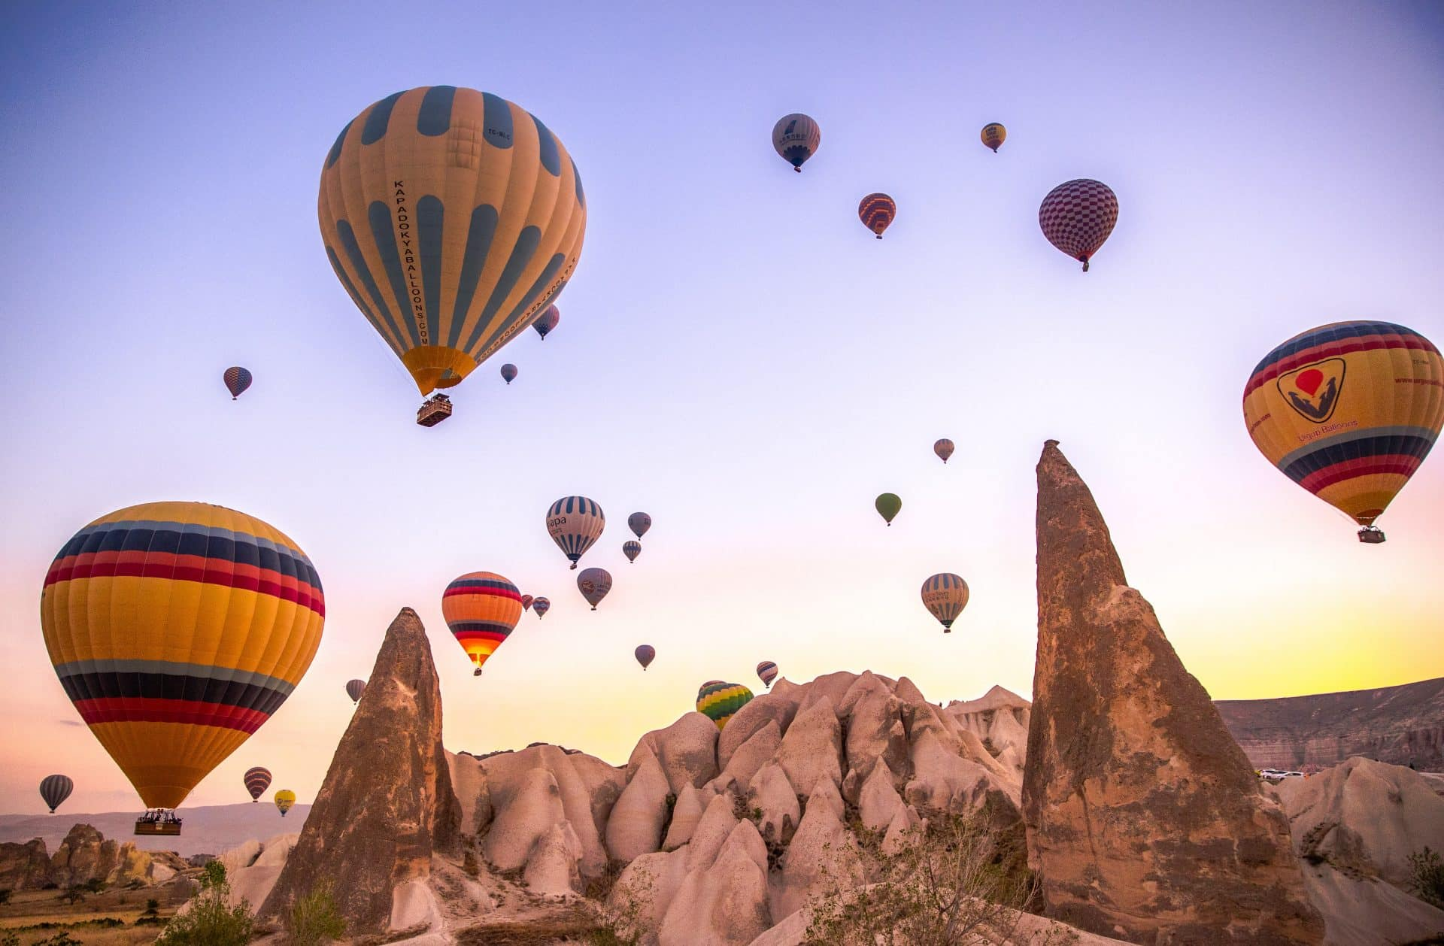
WHICH ACTIVITY IS IN THE PICTURE?
FLY IN A BALLOON

Slide 11
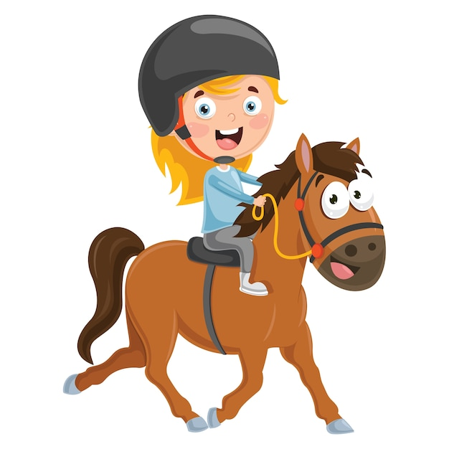
WHICH ACTIVITY IS IN THE PICTURE?
RIDE A HORSE

Slide 12
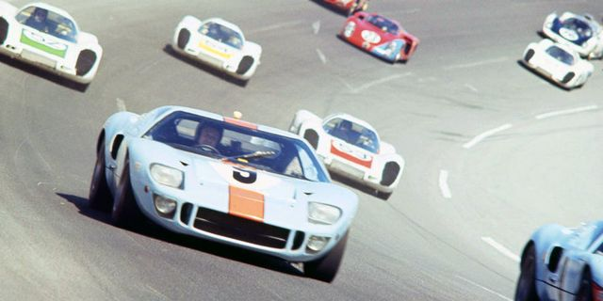
WHICH ACTIVITY IS IN THE PICTURE?
DRIVE A RACING CAR

Slide 13
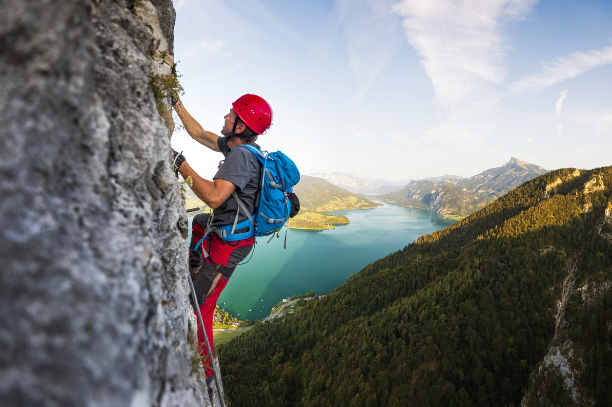
WHICH ACTIVITY IS IN THE PICTURE?
CLIMB A MOUNTAIN

Slide 14
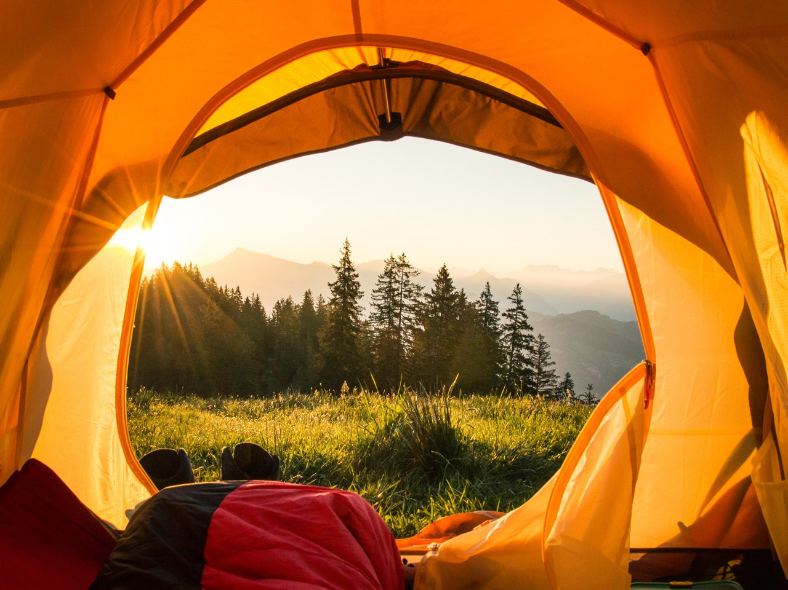
WHICH ACTIVITY IS IN THE PICTURE?
SLEEP IN A TENT

Slide 15
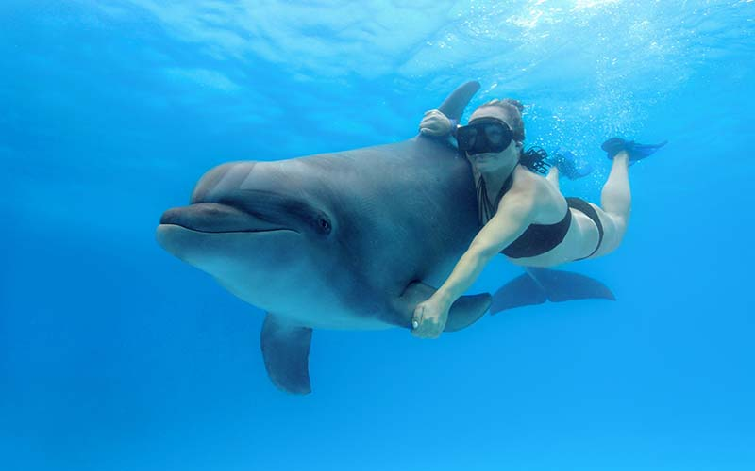
WHICH ACTIVITY IS IN THE PICTURE?
SWIM WITH A DOLPHIN

Slide 16
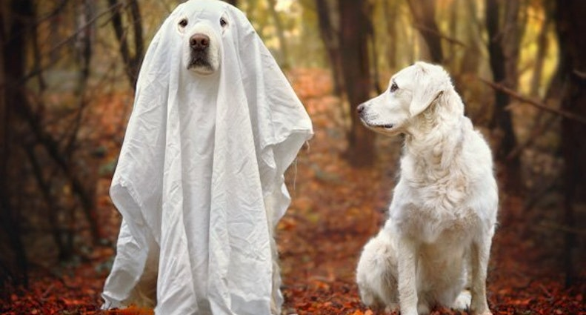
WHICH ACTIVITY IS IN THE PICTURE?
SEE A GHOST

Slide 17
HOMEWORK
STUDY FOR THE TEST (maY 14)
Make your project (maY 15)

Slide 18
Lesson Plan
5 mins test
warm-up
reading – practice
present perfect – practice
vocabulary – practice
homework

