Slide 1
Funny THURSDAY
REVISION QUIZ U3

Slide 2
Lesson Plan
feedback
warm-up
REVISION QUIZ
homework

Slide 3
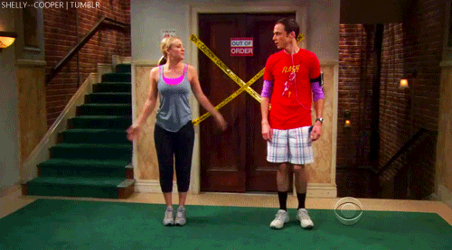
WARM-UP!
https://www.flippity.net/fc.php?k=1z63kMWGQGnkm-JcfFqaF3GquTkJiRWsHoIRk8IuYLCY

Slide 4
FEEDBACK

Slide 5
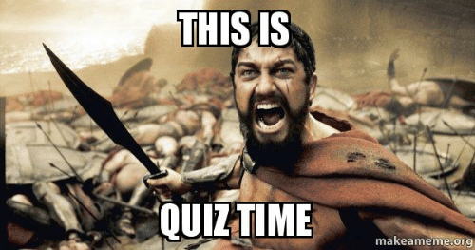
Quiz time
https://www.flippity.net/qs.php?k=1SCNjDeKu6KwNw3SeZIuccCoQPcHrbKWmZQeDS7O9MY4

Slide 6
HOMEWORK
study for the test
make your project

Slide 7
Lesson Plan
feedback
warm-up
REVISION QUIZ
homework

