Slide 1

Revision
Unit 4

Slide 2

Lesson Plan
check your homework
warm-up
listening practice
indefinite pronouns – practice
vocabulary - practice
homework

Slide 3
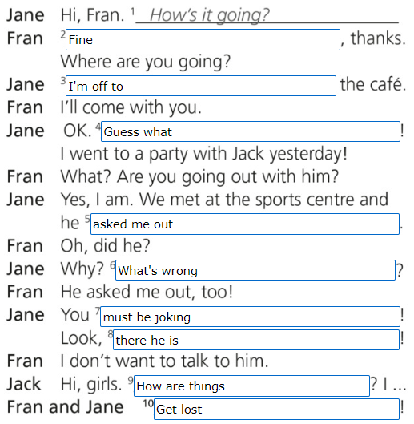
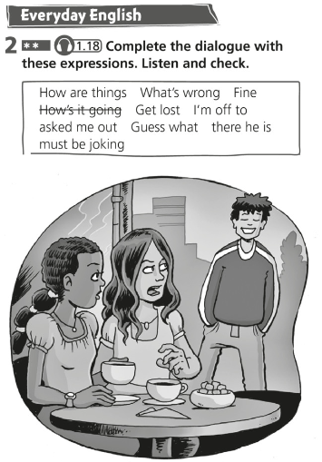
CHECK
YOUR HOMEWORK

Slide 4
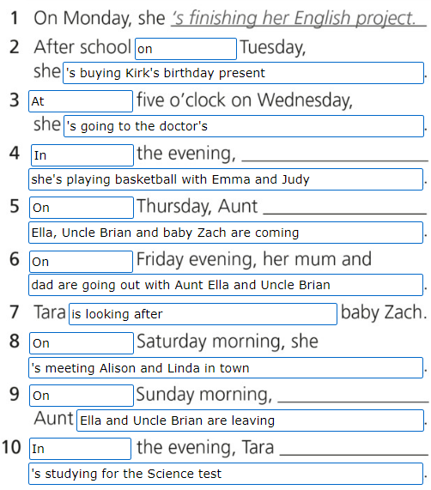
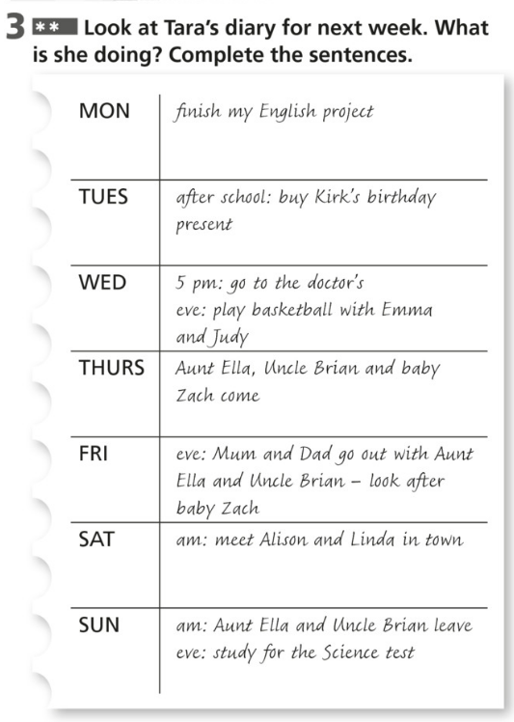
CHECK
YOUR HOMEWORK!

Slide 5
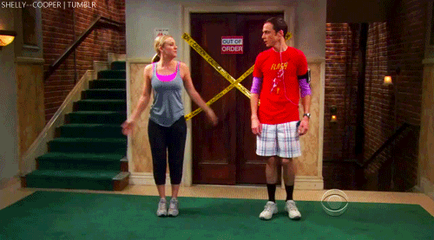
WARM-UP!
https://www.flippity.net/fc.php?k=1z63kMWGQGnkm-JcfFqaF3GquTkJiRWsHoIRk8IuYLCY

Slide 6
WORKBOOK
p. 42, ex. 3

Slide 7

LISTENING PRACTICE
1 Listen to the directions and complete the sentences.
Sally comes out of the station and turns left.
She walks to the _____________.
At the traffic lights she _____________.
The park is on the _____________.
Then she turns right at the _____________.
She comes to a _____________.
Then she goes on until she gets to the _____________.
Then she goes straight across and it’s _____________.
traffic lights
goes straight on
right
crossroads
crossing
next crossroads
on the corner

Slide 8
INDEFINITE PRONOUNS practice
2. Choose the correct word.
He couldn’t see anyone / everybody / no-one he knew.
Katy bought everywhere / everything / nothing she needed at the market.
We stayed at home all weekend. We didn’t go nowhere / anywhere / somewhere.
There was no-one / everywhere / nothing in the fridge.
I thought I saw everything / someone / anyone standing outside the window.
We’ve looked somewhere / anyone / everywhere, but we can’t find the TV remote control.
I had to stop walking because there was nothing / something / anything in my shoe.
I arrived late and everybody / nothing / somewhere stared at me!

Slide 9
INDEFINITE PRONOUNS practice
4. Complete the sentences with these words.
I’ve got something to tell you.
I can't find my car keys ________! I think I have lost them!
________ laughed when the clown fell over.
Is there ________ I can do to help?
After the flood my family was left with ________.
I called the police when I heard ________ scream.
We have looked ________ but we still can't find the car keys.
I've seen you ________ before! Where was it?
anywhere
Everyone
anything
nothing
someone
everywhere
somewhere

Slide 10
INDEFINITE PRONOUNS practice
3. Complete the sentences. Choose from these words.
Nobody
everywhere
something
nothing
anything
Everyone
someone
everything
________ wants to be lonely. We all want friends.
We spent a week in London and we went ________!
Can you buy me _________ to read?
I’ve got _________ to do. I’m bored.
I saw a film last night but I can’t remember ________ about it!
I was really happy when _________ came to my party.
When I dropped my purse, _________ picked it up and took it to the police station.
He ate ________ on his plate because he was really hungry.

Slide 11

VOCABULARY
STATUE

Slide 12

VOCABULARY
CLOCK

Slide 13
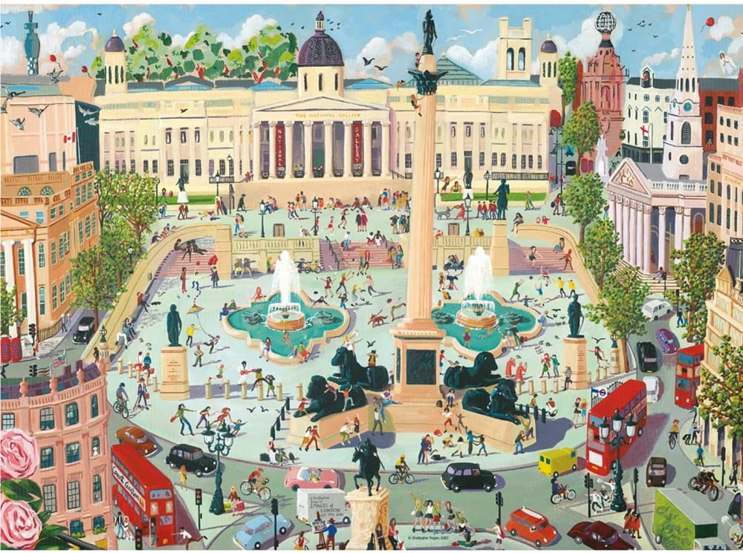
VOCABULARY
SQUARE

Slide 14
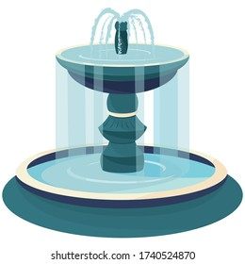
VOCABULARY
FOUNTAIN

Slide 15
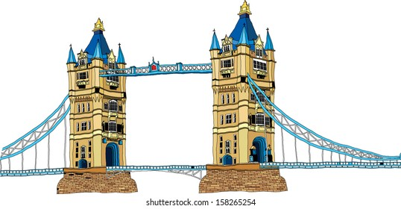
VOCABULARY
BRIDGE

Slide 16
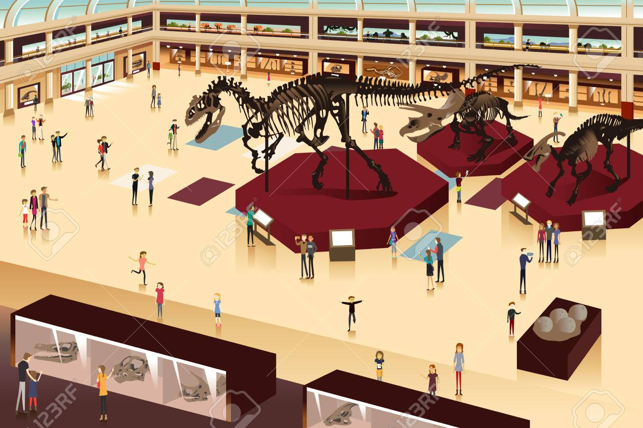
VOCABULARY
MUSEUM

Slide 17

VOCABULARY
PALACE

Slide 18

PROJECT REMINDER
TRAVEL GUIDE

Slide 19

HOMEWORK
STUDY FOR THE TEST (MAR 31)
MAKE YOUR PROJECT (APR 3)
IRREGULAR VERBS

Slide 20

Lesson Plan
check your homework
warm-up
listening practice
indefinite pronouns – practice
vocabulary - practice
homework

