Slide 1
Revision
Unit 3

Slide 2
Lesson Plan
check your homework
warm-up
listening practice
past continuous – practice
vocabulary (phrases) - practice
homework

Slide 3
CHECK YOUR HOMEWORK!

Slide 4
CHECK YOUR HOMEWORK!

Slide 5
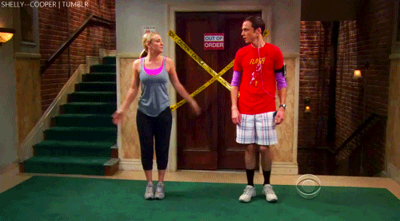
WARM-UP!
https://www.flippity.net/fc.php?k=1z63kMWGQGnkm-JcfFqaF3GquTkJiRWsHoIRk8IuYLCY

Slide 6
CROSSWORD

Slide 7
CROSSWORD

Slide 8
LISTENING PRACTICE
1 Listen and answer the questions.
He was watching TV.
A detective series was on television.
He was walking in the park.
The children were cycling around the lake.
The programme was boring at the beginning.
The children found a body in the lake.
The girl found a body under a car.
The dog found the murderer.
What was the speaker doing last night?
What programme was on television?
Where was the man walking?
What were the children doing?
What was the programme like at the beginning?
Who found a body in the lake?
Where did the girl find a body?
What did the dog do?

Slide 9
PAST CONTINUOUS practice
4. Complete the sentences. Use the past simple form of the verbs in brackets..
Patricia was sending an e-mail. (send)
We _____________ dinner at 8.00. (have)
Bryan _____________ a shower. (not have)
Mercy _____________ a ball in the park. (throw)
Tom _____________ a hat. (not wear)
The boys _______________ TV. (not watch)
Mary and John _____________ on the sofa. (sit)
Chris and Simon _____________ on the phone. (talk)
wasn‘t wearing
were having
weren‘t watching
wasn‘t having
were sitting
was throwing
were talking

Slide 10
PAST CONTINUOUS practice
4. Correct the sentences.
Anna was play the guitar.
Mick and Richard was taking photos.
Dad was to feeding the dog.
I were cleaning my shoes.
They were geting ready for school.
My friends were buiing clothes.
Zac was to read a sports magazine.
playing
getting
were
buying
reading
was

Slide 11
VOCABULARY practice

Slide 12
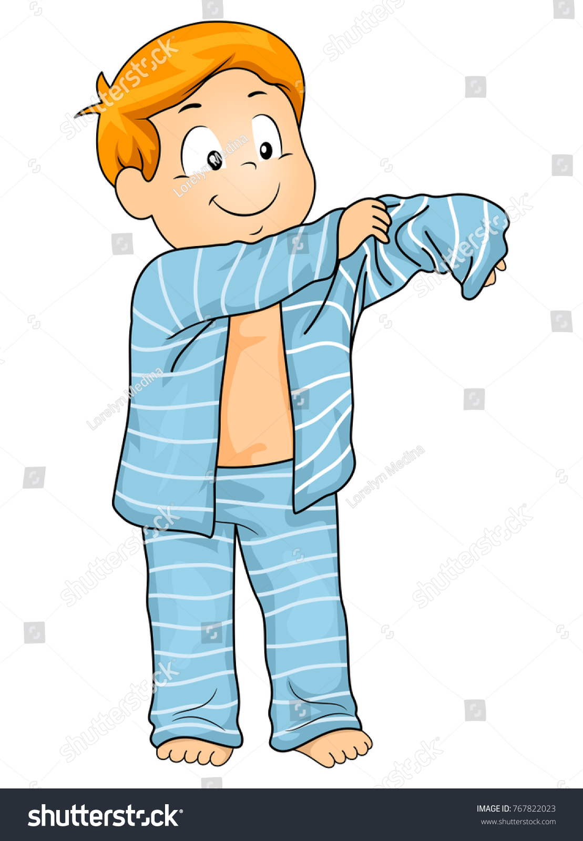
VOCABULARY practice

Slide 13
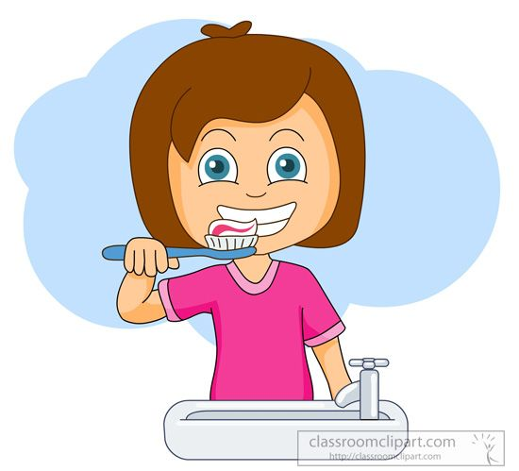
VOCABULARY practice

Slide 14
VOCABULARY practice

Slide 15
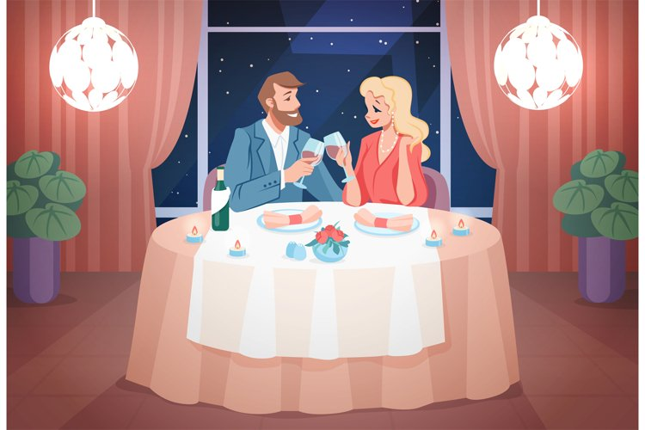
VOCABULARY practice

Slide 16
VOCABULARY practice

Slide 17
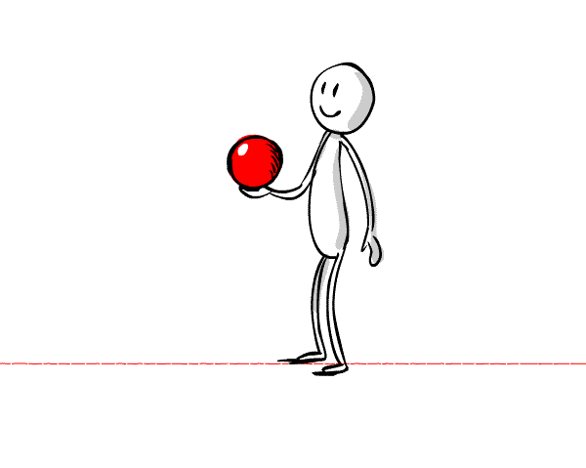
VOCABULARY practice

Slide 18
PROJECT REMINDER
THE COUNTRY

Slide 19
HOMEWORK
STUDY FOR THE TEST (FEB 15)
IRREGULAR VERBS

Slide 20
Lesson Plan
check your homework
warm-up
listening practice
past continuous – practice
vocabulary (phrases) - practice
homework

