Slide 1
Revision II
Unit 3

Slide 2
Lesson Plan
5 mins test
warm-up
reading - practice
past simple: Qs - practice
vocabulary – practice
homework

Slide 3
5 mins test

Slide 4
5 mins test
CZECH | BASE FORM | PAST SIMPLE | PAST PARTICIPLE
MYSLET
 | GIVE
 |  | READ
 |  |  | TOLD
DRŽET
 | THROW

Slide 5
READING PRACTICE
1. Read the text and Answer the questions.
Why did the woman go into the post office?
Who was she with?
What time was it?
Who was waiting at the desk?
Because she wanted to post some letters.
She was with her sons.
It was about eleven o’clock.
A young man was waiting at the desk.

Slide 6
READING PRACTICE
1. Read Tina’s email. Answer the questions.
A second robber came into the post office. What did he look like?
How many policemen ran into the post office?
What did the second policeman do while the other policeman was shouting at the robber?
The second robber was tall with blond hair.
Five policemen ran into the post office.
The second policemen jumped on the robber with the gun.

Slide 7
PAST SIMPLE: Qs - PRACTICE
2. Complete the dialogue.
A. parents / where / your / were / ?
B. in / they / living / sitting / room / were / the
A. anything / you / could / see / ?
B. ash / cloud / I / big / saw / of / a
A. were / doing / what / people / ?
B. the / they / street / were / running / into
A. Where were your parents?
B. They were sitting in the living room.
A. Could you see anything?
B. I saw a big cloud of ash.
A. What were people doing ?
B. They were running into the street.

Slide 8
PAST SIMPLE x PAST CONTINUOUS
4. Choose the correct words.
I was reading / read in my room when Elsie knocked on the door.
1. We were playing cards when Mum brought / was bringing us some sandwiches.
2. Tina cleaned / was cleaning the kitchen floor when Richard walked into the room.
3. They were crossing the road when they saw / were seeing Jim.

Slide 9
PAST SIMPLE x PAST CONTINUOUS
4. Choose the correct words.
4. The children talked / were talking when the teacher came into class.
5. Matthew was writing / wrote a text message when his phone rang.
6. The dogs were chasing a cat when they were jumping / jumped over a wall.
7. The boys were swimming / swam in the sea when it started to rain.

Slide 10
VOCABULARY PRACTICE
What is this?
EXPLOSION

Slide 11
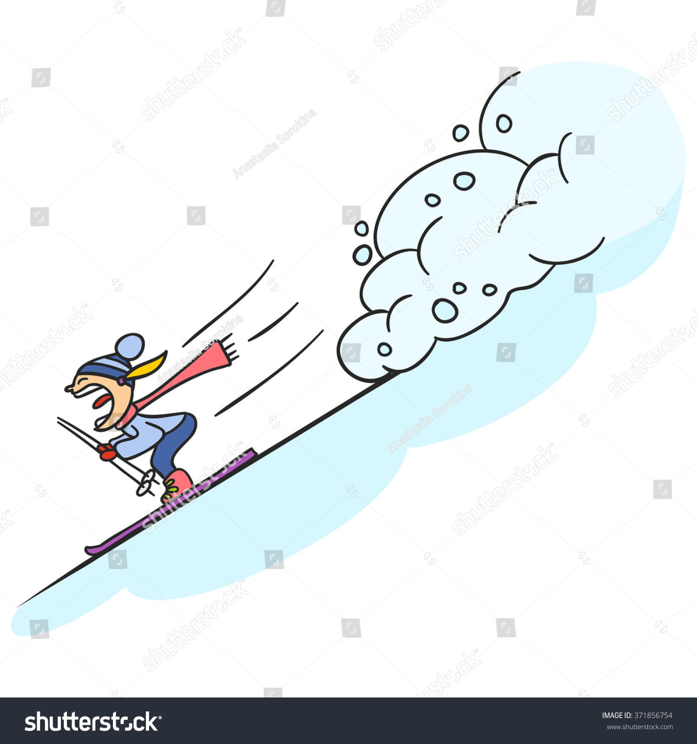
VOCABULARY PRACTICE
What is this?
AVALANCHE

Slide 12
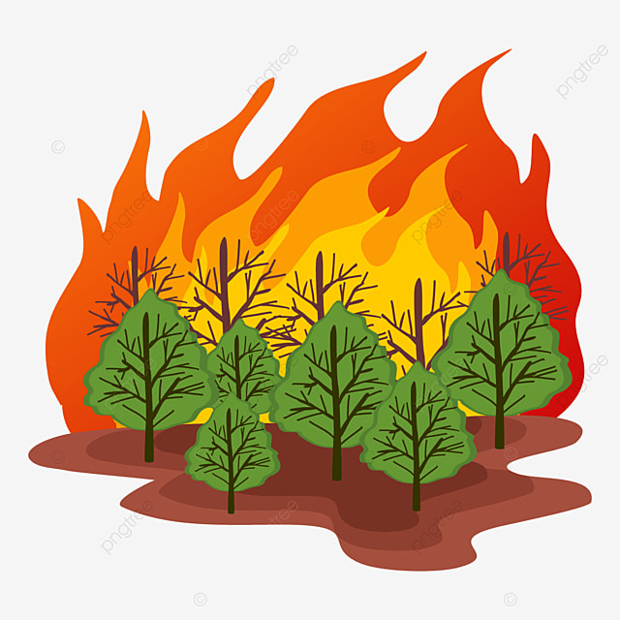
VOCABULARY PRACTICE
What is this?
FOREST FIRE

Slide 13
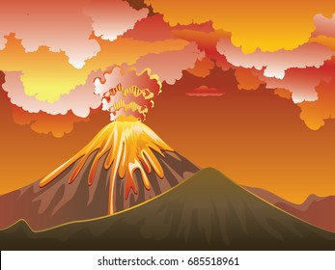
VOCABULARY PRACTICE
What is this?
VOLCANIC ERUPTION

Slide 14
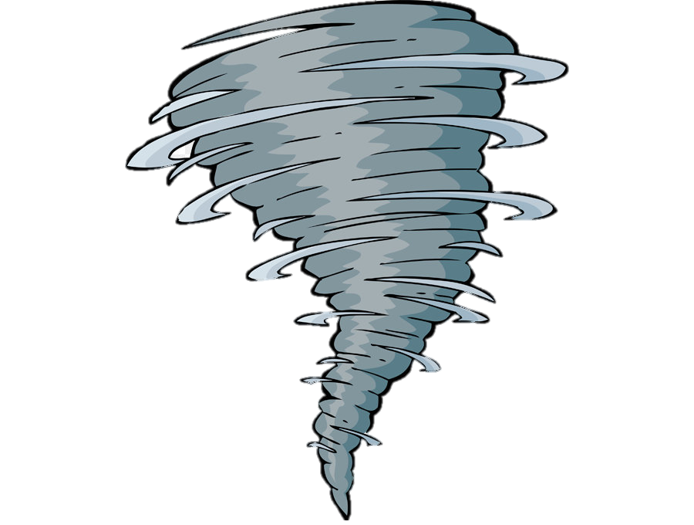
VOCABULARY PRACTICE
What is this?
TORNADO

Slide 15
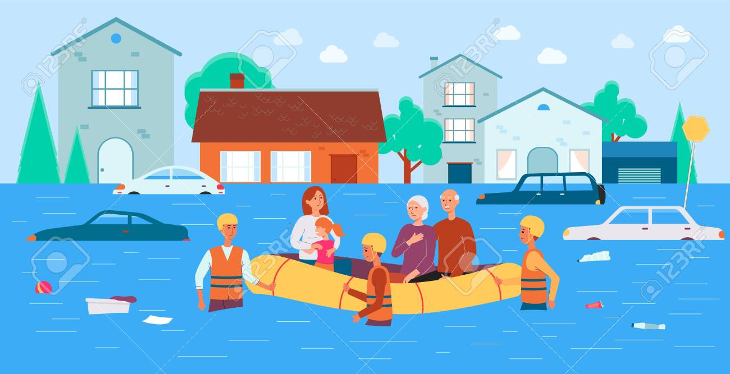
VOCABULARY PRACTICE
WHAT IS IT?
FLOOD

Slide 16
HOMEWORK
STUDY FOR THE TEST (FEB 15;)

Slide 17
Lesson Plan
5 mins test
warm-up
reading - practice
past simple: Qs - practice
vocabulary – practice
homework

