Slide 1
Layla‘s news
Present Perfect + JUST
Everyday English

Slide 2
Lesson Plan
check your homework
warm-up
SB – story
present perfect + just - introduction
WB – Everyday English - practice
homework

Slide 3
CHECK YOUR HOMEWORK!

Slide 4
CHECK YOUR HOMEWORK!
Isabel has ridden a horse.
She has climbed a mountain.
She‘s never done a bungee jump.
She has swum with dolphins.
She‘s never driven a racing car.

Slide 5
CHECK YOUR HOMEWORK!

Slide 6
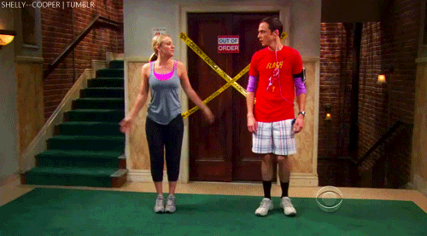
WARM-UP!
https://www.flippity.net/fc.php?k=1z63kMWGQGnkm-JcfFqaF3GquTkJiRWsHoIRk8IuYLCY

Slide 7
WARM-UP!
UČIT
VĚDĚT, ZNÁT
NOSIT
STÁT (CENA)
DÁT, POLOŽIT

Slide 8
STUDENT‘S BOOK
p. 50 Watch the video.
p. 62 Watch the video.
Read the story.
Find words you don‘t understand.
What has happened to virtual Matt?
Why is Dylan shocked?
Find „just“ in the text.

Slide 9
USING PRESENT PERFECT
experience, „life score“
I've been to the USA twice.
I haven't seen the film.
changes, „something is different today“
I've become a teacher.
I've lost my keys.
something happened recently (nedávno, v poslední době)
I haven't seen her recently.
Have you taken out the garbage yet?

Slide 10
PRESENT PERFECT + JUST
Would you like something to eat?
No, thanks. We‘ve just had lunch.
Do you want to go to the cinema?
Sure! I‘ve just finished my homework.

Slide 11
WORKBOOK
p. 50, ex. 2, 3

Slide 12
HOMEWORK
vocabulary 5D

Slide 13
Lesson Plan
check your homework
warm-up
SB – story
present perfect + just - introduction
WB – Everyday English - practice
homework

