Slide 1
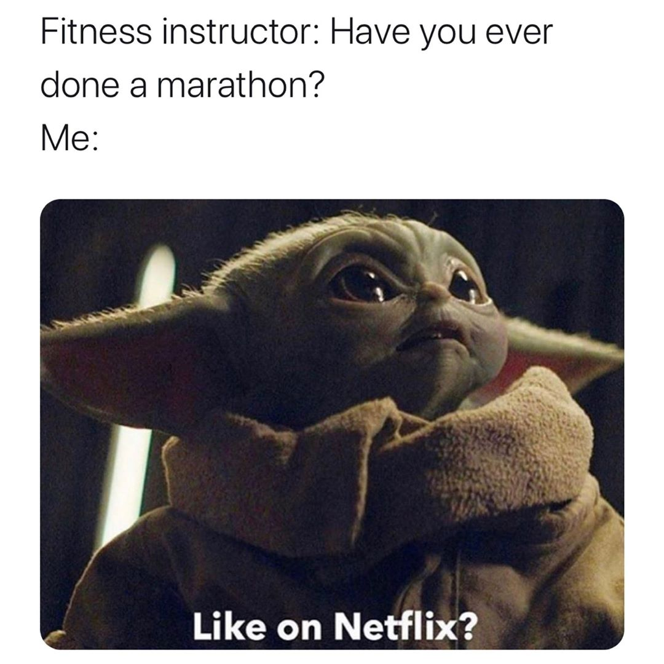
Present perfect
Questions; ever and never

Slide 2
Lesson Plan
check your homework
warm-up
SB – story
present perfect: Qs – introduction
WB – practice
homework

Slide 3
CHECK YOUR HOMEWORK!

Slide 4
CHECK YOUR HOMEWORK!

Slide 5
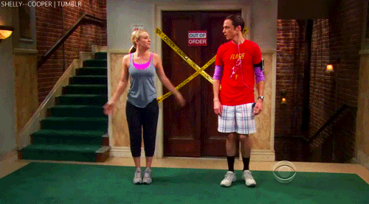
WARM-UP!
https://www.flippity.net/fc.php?k=1z63kMWGQGnkm-JcfFqaF3GquTkJiRWsHoIRk8IuYLCY

Slide 6
WARM-UP!
JEZDIT
DÁT
KOUSAT
PSÁT
UHODIT

Slide 7
STUDENT‘S BOOK
p. 58 Watch the video.
Read the story.
Find words you don‘t understand.
Why is Sweet Sue happy at the end?
Have you ever …? Yes, I have. / No, I haven‘t.

Slide 8
PRESENT PERFECT - QUESTION

Slide 9
WORKBOOK
p. 46, ex. 3

Slide 10
HOMEWORK
vocabulary 5B

Slide 11
Lesson Plan
check your homework
warm-up
SB – story
present perfect: Qs – introduction
WB – practice
homework

