Slide 1
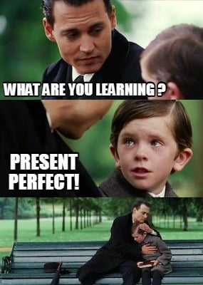
Present perfect
practice

Slide 2
Lesson Plan
5 mins test
warm-up
present perfect - revision
present perfect x past simple
present perfect - practice
homework

Slide 3
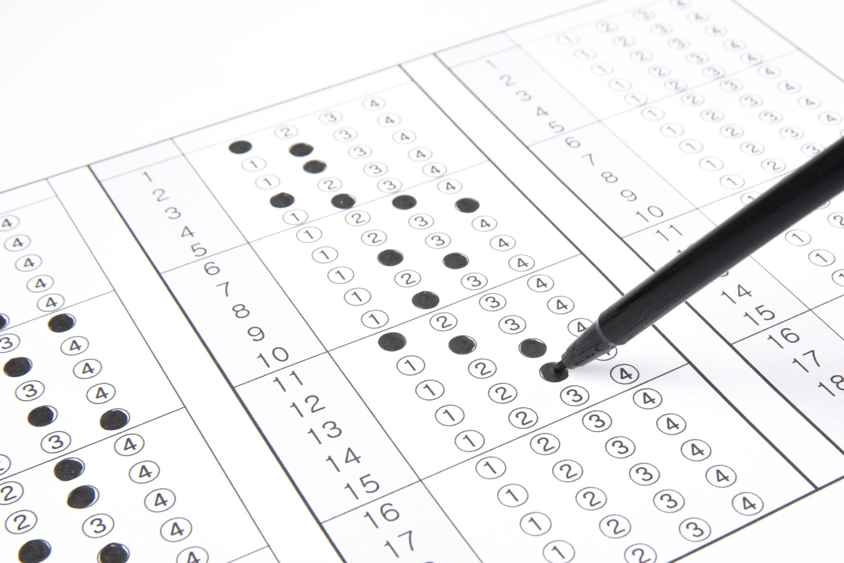
5 mins test

Slide 4
5 mins test
A
B
porouchat se
motokára
skutečný
posunout se nahoru, postoupit
SPÁLIT
BĚHAT
hrát hlavní roli, zazářit
až do teď
závodní dráha
hrdinka
PSÁT
KOUSAT

Slide 5
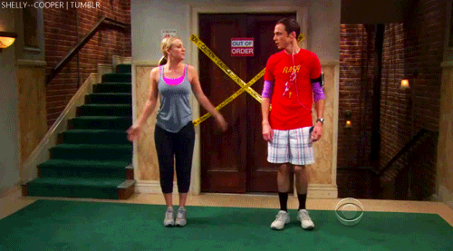
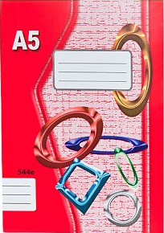
WARM-UP!
https://www.flippity.net/fc.php?k=1z63kMWGQGnkm-JcfFqaF3GquTkJiRWsHoIRk8IuYLCY

Slide 6
WORKBOOK
p. 44, ex. 1, 3

Slide 7
PRESENT PERFECT
SUBJECT – HAVE/HAS – 3rd form – rest of the sentence

Slide 8
PRESENT PERFECT
SUBJECT – HAVEN‘T/HASN‘T – 3rd form – rest of the sentence

Slide 9
USING PRESENT PERFECT
experience, „life score“
I've been to the USA twice.
I haven't seen the film.
changes, „something is different today“
I've become a teacher.
I've lost my keys.
something happened recently (nedávno, v poslední době)
I haven't seen her recently.
Have you taken out the garbage yet?

Slide 10
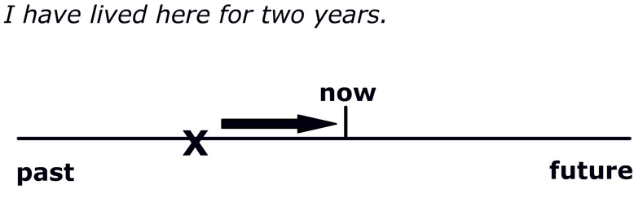
PRESENT PERFECT

Slide 11
STUDENT‘S BOOK
p. 57, ex. 4b)

Slide 12
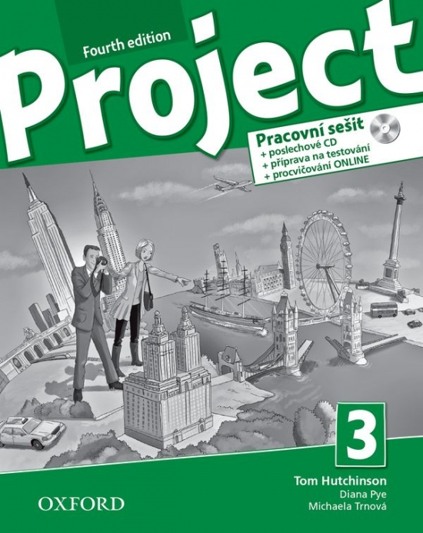
WORKBOOK
p. 44, ex. 1

Slide 13
WORKSHEET
UNIT 4 GRAMMAR

Slide 14
4. Complete the sentences. Use the present perfect form of the verbs in brackets.
Maria and Jacky __________________ to school today. [not go]
Dad ________________ an enormous fish. [catch]
They ________________ the new James Bond film. [not see]
I ________________ an email from my sister in Australia. [have]
Elsie ________________ her homework. [not do]
Carla ________________ me a birthday present. [give]
My cousins ________________ in a plane for the first time this year. [fly]
Our neighbours ________________ us a postcard from Rome. [send]
HAVEN‘T GONE
HAS CAUGHT
HAVEN‘T SEEN
HAVE HAD
HASN‘T DONE
HAS GIVEN
HAVE FLOWN
HAVE SENT

Slide 15
1. Write complete sentences. Use the pres. perfect.
I haven’t read my book.
Our class hasn’t won the sports prize.
Milly has taken the dog for a walk.
They haven’t done anything.
Thomas has tidied his room.
We’ve made a chocolate cake.
Beth hasn’t bought any new clothes.
The boys in my class haven’t done their homework.
I / not read / my book
our class / not win / the sports prize
Milly / take / the dog / for a walk
they / not do / anything
Thomas / tidy / his room
we / make / a chocolate cake
Beth / not buy / any new clothes
the boys in my class / not do / their homework

Slide 16
HOMEWORK
WORKBOOK
p. 44, ex. 2, 4
vocabulary 5B

Slide 17
Lesson Plan
5 mins test
warm-up
present perfect - revision
present perfect x past simple
present perfect - practice
homework

