Slide 1
Everyday English Making arrangements

Slide 2
Lesson Plan
5 mins test
warm-up
indefinite pronouns – introduction
indefinite pronouns – revision
homework

Slide 3
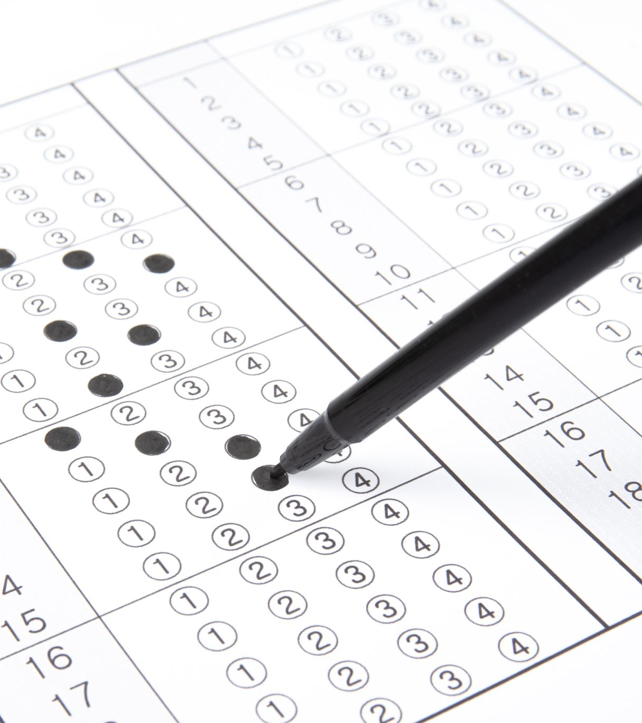
5 mins test

Slide 4
5 mins test
A
B
Hádej co!
potápět se
zmatený
minulost
ODEJÍT, OPUSTIT
ZAČÍT
Ztrať se! Vypadni!
pozvat někoho na rande
vést
přítomnost
VZÍT
SLYŠET

Slide 5
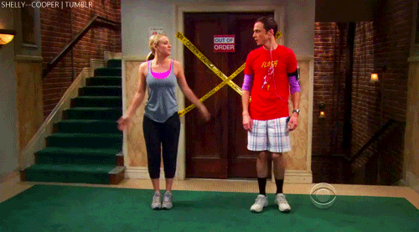
WARM-UP!
https://www.flippity.net/fc.php?k=1z63kMWGQGnkm-JcfFqaF3GquTkJiRWsHoIRk8IuYLCY

Slide 6
WORKBOOK
p. 43, ex. 4

Slide 7
WARM-UP FOR EVERYBODY!
ASK YOUR CLASSMATE!

Slide 8
STUDENT‘S BOOK
p. 39, ex. 4a)

Slide 9
STUDENT‘S BOOK
p. 39, ex. 3

Slide 10
STUDENT‘S BOOK

Slide 11
STUDENT‘S BOOK
On Monday he‘s having lunch with the Prime Minister.
On Tuesday he‘s going to Buckingham Palace.
On Wednesday he‘s appearing on TV.
On Thursday he‘s playing tennis at Wibledon.
On Friday he‘s flying to New York.
On Saturday he‘s meeting the US Presaident.
On Sunday he‘s going scuba-diving.

Slide 12
WORKBOOK
p. 41, ex. 4

Slide 13
HOMEWORK
vocabulary 4D

