Slide 1
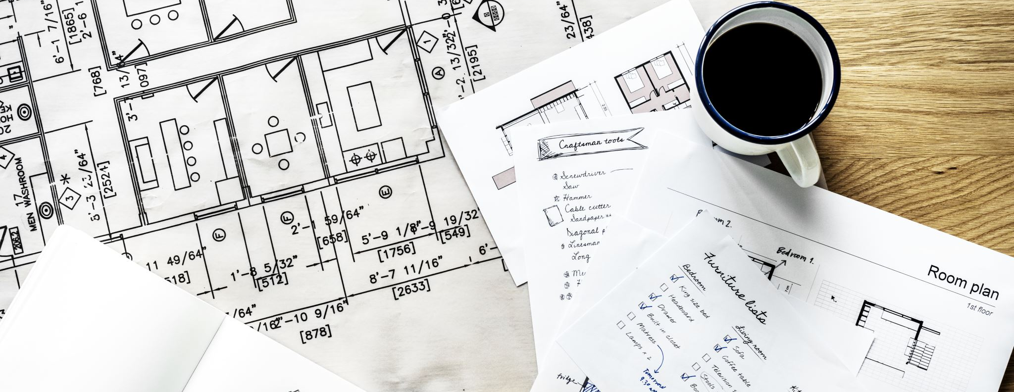
Dylan‘s plan
Everyday English

Slide 2
Lesson Plan
check your homework
warm-up
SB - story
WB – practice
homework

Slide 3
CHECK YOUR HOMEWORK!

Slide 4
CHECK YOUR HOMEWORK!

Slide 5
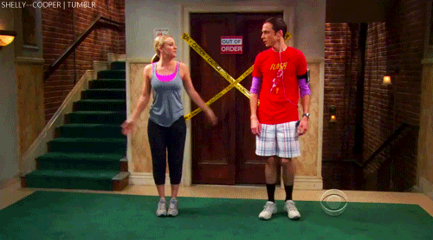
WARM-UP!
https://www.flippity.net/fc.php?k=1z63kMWGQGnkm-JcfFqaF3GquTkJiRWsHoIRk8IuYLCY

Slide 6
WORD SCRAMBLE

Slide 7
STUDENT‘S BOOK
Watch the video from p. 38
p. 50 Watch the video.
Read the story.
Are there any words you don‘t understand?
Who is Matt Jenkins?
Who is Matt Daytona?
What is Layla going to do in her computer game?
Why is Dylan angry?
p. 50, ex. 1b) Complete the sentences with the correct surname.

Slide 8
WORKBOOK
p. 40, ex. 1, 2

Slide 9
HOMEWORK
vocabulary 4D

