Slide 1
The Tailor of Swaffham
some/any/every/no –body
some/any/every/no – thing

Slide 2
Lesson Plan
check your homework
warm-up
indefinite pronouns – introduction
indefinite pronouns – practice
homework

Slide 3
CHECK YOUR HOMEWORK!

Slide 4
CHECK YOUR HOMEWORK!

Slide 5
CHECK YOUR HOMEWORK!

Slide 6
CHECK YOUR HOMEWORK!

Slide 7
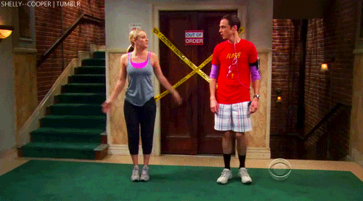
WARM-UP!
https://www.flippity.net/fc.php?k=1z63kMWGQGnkm-JcfFqaF3GquTkJiRWsHoIRk8IuYLCY

Slide 8
Tailor of Swaffham - VOCAB
tailor hlas silly chodník
wake up majitel obchodu set off popadnout
dig poklad arrive rýč
oak vzbudit busy hloupý
wooden krejčí crowd vydat se na cestu
shopkeeper kopat pavement zaneprázdněný
voice dřevěný spade dav
treasure dub grab přijít, přijet

Slide 9
STUDENT‘S BOOK
p. 47, ex. 1a) Look at the pictures. What is happening in each picture?
Listen to the text.
Find words you don‘t understand.
Put the pictures in the correct order.

Slide 10
WHERE IS SWAFFHAM?
How far is it from London?
169 km
The journey to London took 4 days. How many kilometers did he walk a day?
He walked approximately 42 km a day.

Slide 11
INDEFINITE PRONOUNS
-body | -one | -thing | -where
everybody
 | someone
 |  |  | anywhere
 | no one | nothing
EVERYONE
EVERYTHING
EVERYWHERE
SOMEBODY
SOMETHING
SOMEWHERE
ANYBODY
ANYONE
ANYTHING
NOBODY
NOWHERE

Slide 12
HOMEWORK
vocabulary 4C

