Slide 1
Indefinite pronouns

Slide 2
Lesson Plan
5 mins test
warm-up
indefinite pronouns – introduction
indefinite pronouns – revision
homework

Slide 3
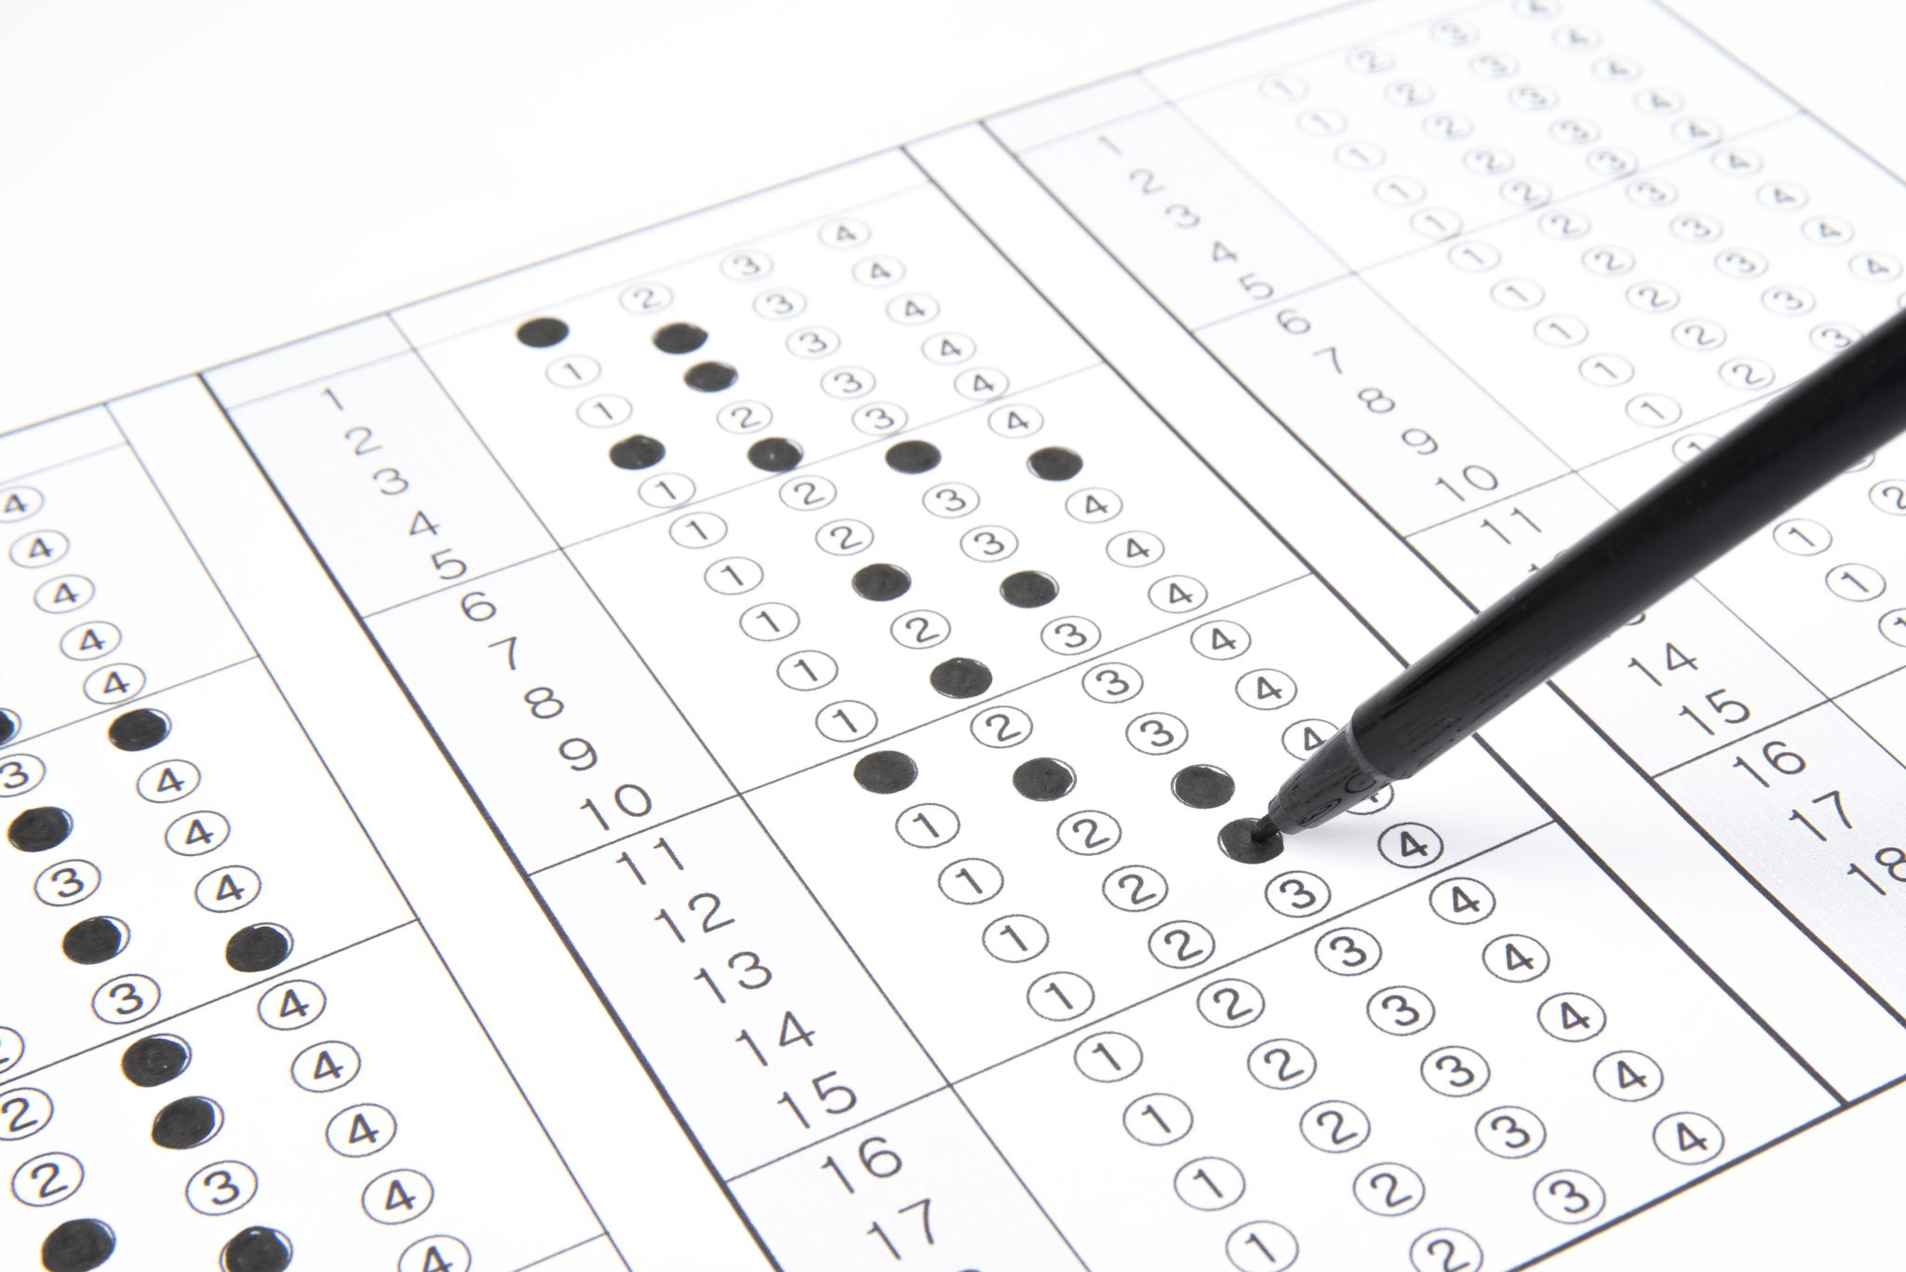
5 mins test

Slide 4
5 mins test
A
B
smát se
usnout
utéct pryč
rýč
NOSIT (NA SOBĚ)
POTOPIT SE
narazit
vydat se
vyskočit
přímo
DRŽET
CHYTIT

Slide 5
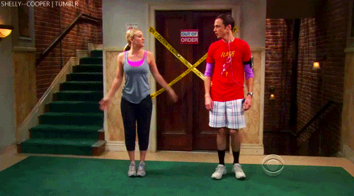
WARM-UP!
https://www.flippity.net/fc.php?k=1z63kMWGQGnkm-JcfFqaF3GquTkJiRWsHoIRk8IuYLCY

Slide 6
INDEFINITE PRONOUNS
-body | -one | -thing | -where
everybody
 | someone
 |  |  | anywhere
 | no one | nothing
EVERYONE
EVERYTHING
EVERYWHERE
SOMEBODY
SOMETHING
SOMEWHERE
ANYBODY
ANYONE
ANYTHING
NOBODY
NOWHERE

Slide 7
STUDENT‘S BOOK
p. 49, ex. 4b)

Slide 8
WORKBOOK
p. 38, ex. 3

Slide 9
Ask your classmate!

Slide 10
Ask your classmate!

Slide 11
HOMEWORK
vocabulary 4C

Slide 12
Lesson Plan
5 mins test
warm-up
indefinite pronouns – introduction
indefinite pronouns – revision
homework

