Slide 1
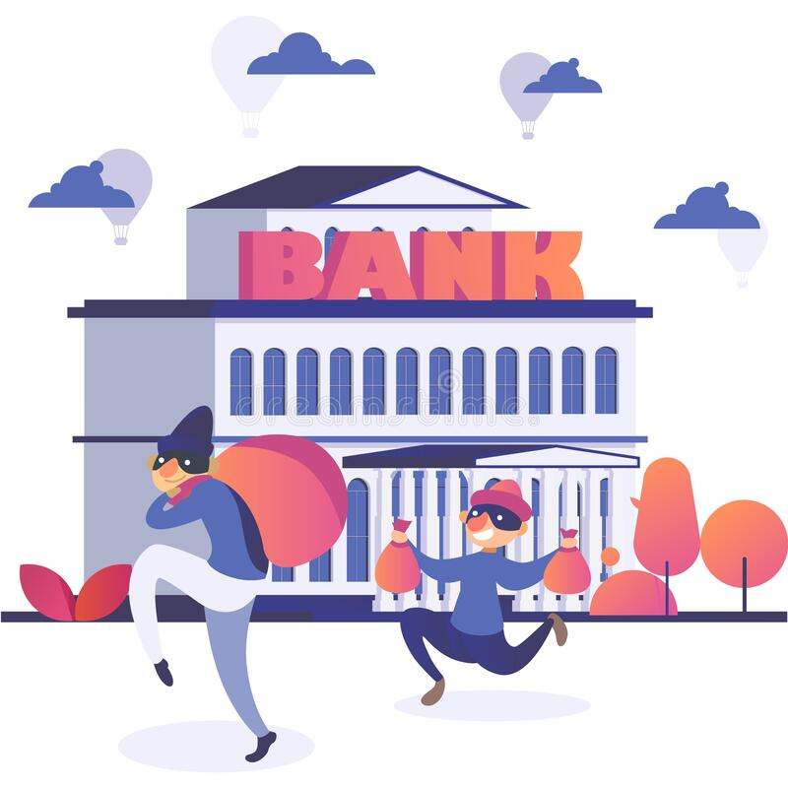
Sweet Sue and the bank robbers
the, a / an

Slide 2
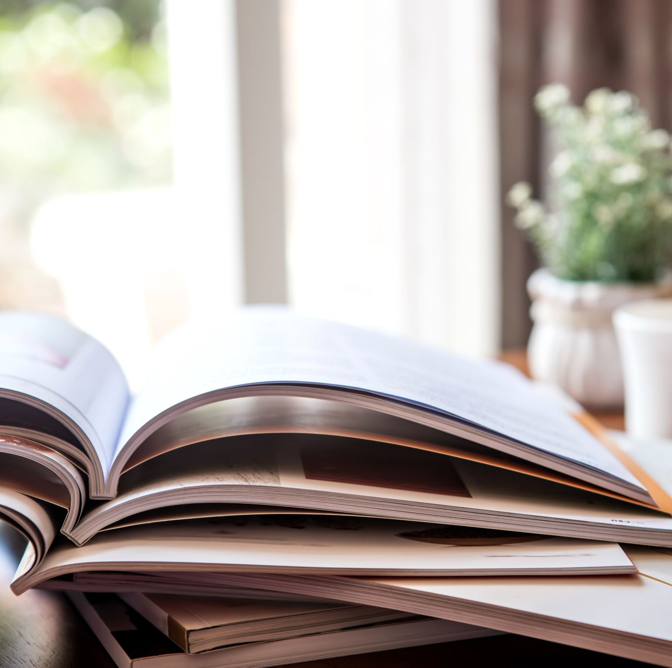
Lesson Plan
check your homework
warm-up
SB - story
articles - introduction
WB – practice
homework

Slide 3
CHECK YOUR HOMEWORK!

Slide 4
CHECK YOUR HOMEWORK!
in
at
to
on
on
in
to
in
at / in
on
to
in
to
at / in
in
in
on
on

Slide 5
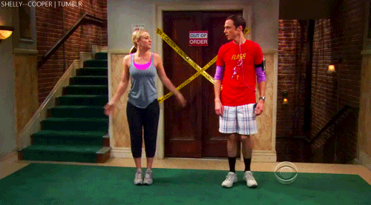
WARM-UP!
https://www.flippity.net/fc.php?k=1z63kMWGQGnkm-JcfFqaF3GquTkJiRWsHoIRk8IuYLCY

Slide 6
THE or -
Choose the correct alternative: the or no article (-).
Our school went to __________ British Museum last Friday.
We didn’t see _____ Big Ben while we were in London.
Uncle Max and Aunt Lily stayed in a hotel opposite _____ Hyde Park.
Let’s visit _____ Houses of Parliament.
Elizabeth was shopping in _____ Oxford Street all day.
I’d like to see _____ Mamma Mia.
Mum and Dad went on a boat along _____ River Thames.
You can visit _____ Buckingham Palace.
THE
-
-
THE
-
-
THE
-

Slide 7
STUDENT‘S BOOK
p. 46, ex. 1 Watch the video.
Read the story.
Are there any words you don‘t understand?
Where do the men want to go?
Why?
Why don‘t they go there?

Slide 8
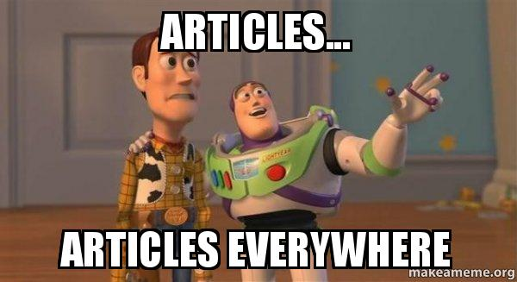
ARTICLES
A / AN
THE
we mention something for the first time
after There is… / Is there …?
we mention something again
with positions: left, right, corner, other side, …
only one possibility
superlatives (the best)

Slide 9
WORKBOOK
p. 36, ex. 1

Slide 10
HOMEWORK
vocabulary 4B

Slide 11
Lesson Plan
check your homework
warm-up
SB - story
articles - introduction
WB – practice
homework

