Slide 1

(In)definite articles: A / AN / THE

Slide 2
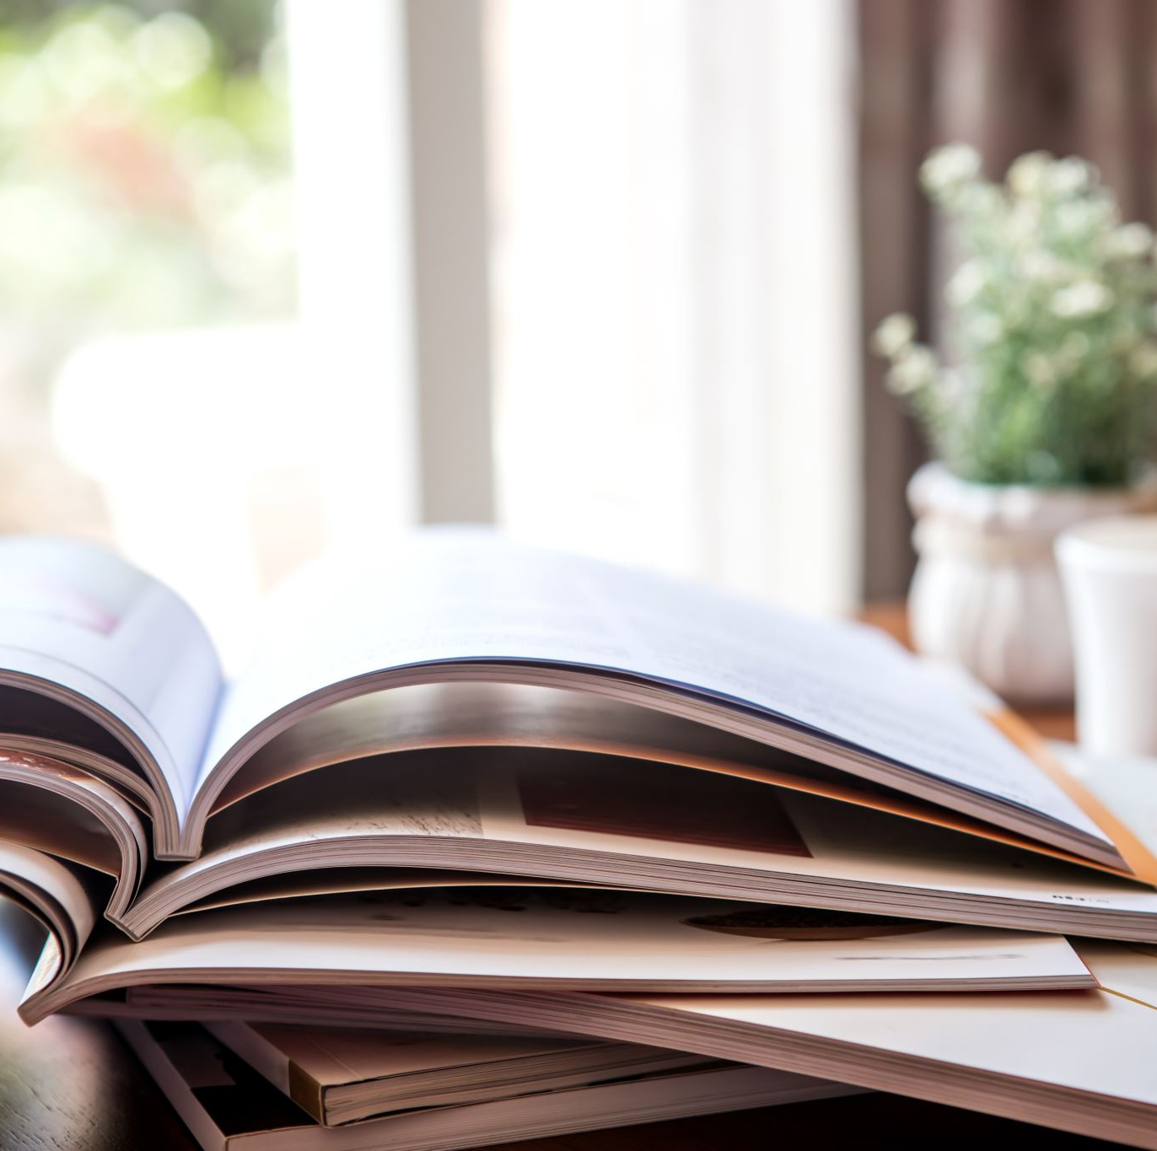
Lesson Plan
5 mins test
warm-up
articles - revision
SB – practice
worksheet – practice
homework

Slide 3
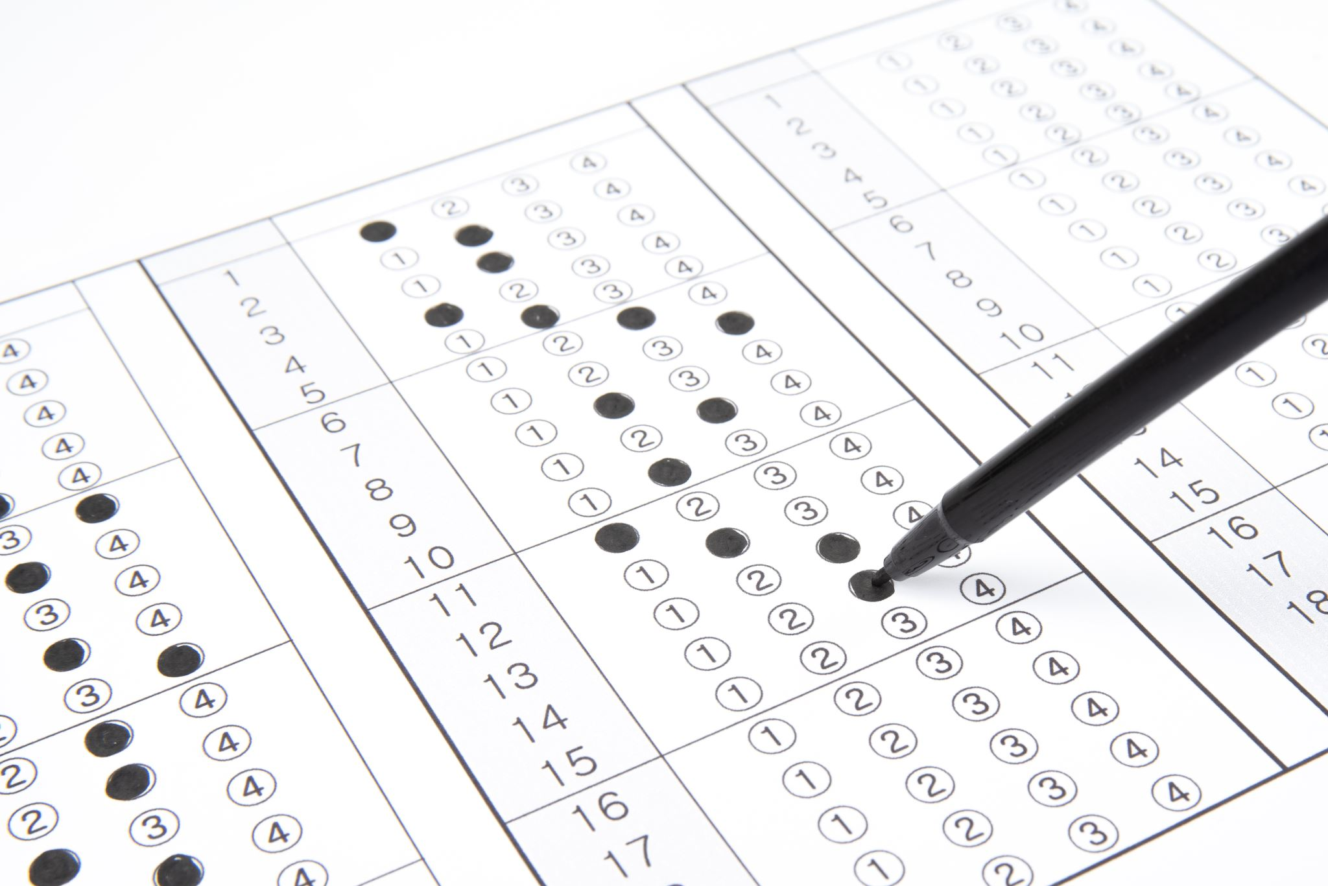
5 mins test

Slide 4
5 mins test
A
B
radnice
podél
zatáčející / zatáčka
semafor
STRÁVIT,UTRATIT
CHYTIT
soud (budova)
rovně (dál)
možnost
kruhový objezd
VZBUDIT SE
JÍT, JET

Slide 5
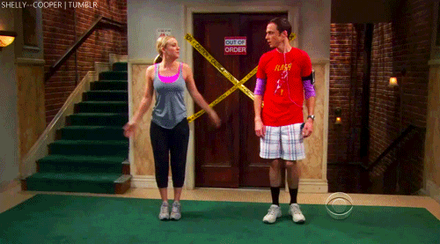
WARM-UP!
https://www.flippity.net/fc.php?k=1z63kMWGQGnkm-JcfFqaF3GquTkJiRWsHoIRk8IuYLCY

Slide 6
WORKBOOK
p. 36, ex. 1

Slide 8
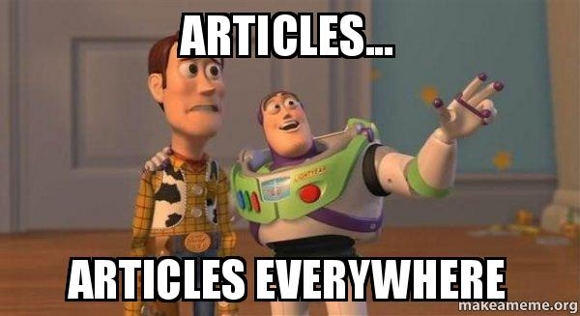
ARTICLES
A / AN
THE
we mention something for the first time
after There is… / Is there …?
we mention something again
with positions: left, right, corner, other side, …
only one possibility
superlatives (the best)

Slide 9
5. Complete the sentences. Use the, a or an.
__________ Houses of Parliament are in London.
Nelson’s Column is __________ famous landmark in Trafalgar Square.
Look! The London Eye is on __________ other side of the River Thames.
A. Excuse me. Is there _________ art gallery near here?
B. Yes, it’s over there, on the other side of Trafalgar Square.
Look at the flag. That means the Queen is inside __________ palace.
Let’s look at __________ dinosaurs in the Natural History Museum.
A Excuse me. Is there __________ park near here?
B Yes, Hyde Park is over there.
A Excuse me. How do I get to Big Ben?
B Walk along here until you see __________ bridge. Go across the bridge and Big Ben is on the other side.
THE
A
THE
AN
THE
THE
A
A

Slide 10
6. Complete the sentences with the, a or an.
Excuse me. How do I get to ________ bus station?
Is there ________ bank near here?
The museum is on ________ right, next to the shops.
The restaurant is next to ________ old museum.
Cross the road and you’ll come to ________ bridge.
The theatre is next to ________ river.
There isn’t ________ art gallery, but there is a museum.
Excuse me. Where’s ________ Savoy Hotel?
THE
A
THE
AN
A
THE
AN
THE

Slide 11
7. Complete the Qs and answers.
A Excuse me. How do I get to the bus station?
B Go across ________ road and it’s opposite the bank.
A Excuse me. Is there ________ bank near here? B Yes, it’s just there on the right.
A Excuse me. Where’s the sports shop?
B It’s on ________ corner.
A Excuse me. Is there ________ art gallery near here?
B Yes, it’s next to the museum.
THE
A
THE
AN

Slide 12
7. Complete the Qs and answers.
A Excuse me. How do I get to the museum?
B Go across the bridge and it’s on ________ left.
A Excuse me. Where’s the Italian restaurant?
B Go past ________ bus stop and it’s on the right.
A Excuse me. Where’s 52 Silver Street?
B Take the first left and you’ll come to ________ bridge. Go across the bridge and it’s the first on your right.
A Excuse me. Is there ________ café near here?
B Yes, go across the road and it’s next to the book shop.
THE
THE
A
A

Slide 13






TIMETABLE

Slide 14
MARCH
1 March Zero Discrimination Day
Self Injury Awareness Day
3 March World Hearing Day
8 March International Women's Day
9 March No Smoking Day
20 March International Day of Happiness
21 March World Down Syndrome Day
22 March World Water Day
25 March International Day of the Unborn Child
26 March Purple Day of Epilepsy
27 March World Theatre Day

Slide 15

HOMEWORK
vocabulary 4B

Slide 16

Lesson Plan
5 mins test
warm-up
articles - revision
SB – practice
worksheet – practice
homework

