Slide 1
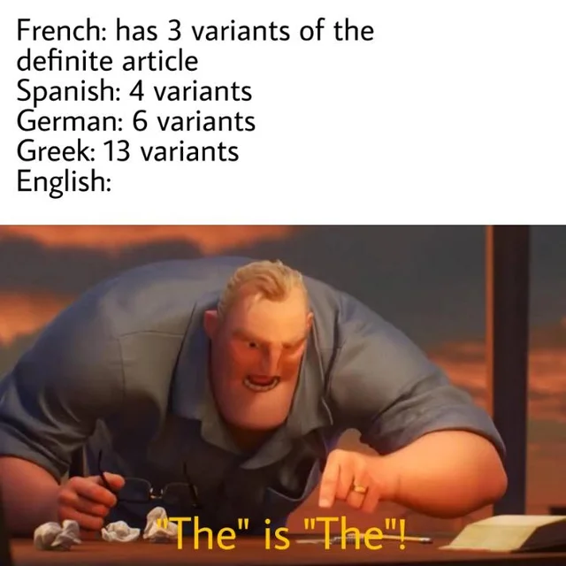
The definite article: THE

Slide 2
Lesson Plan
5 mins test
warm-up
articles
definite article - revision
definite article - practice
homework

Slide 3
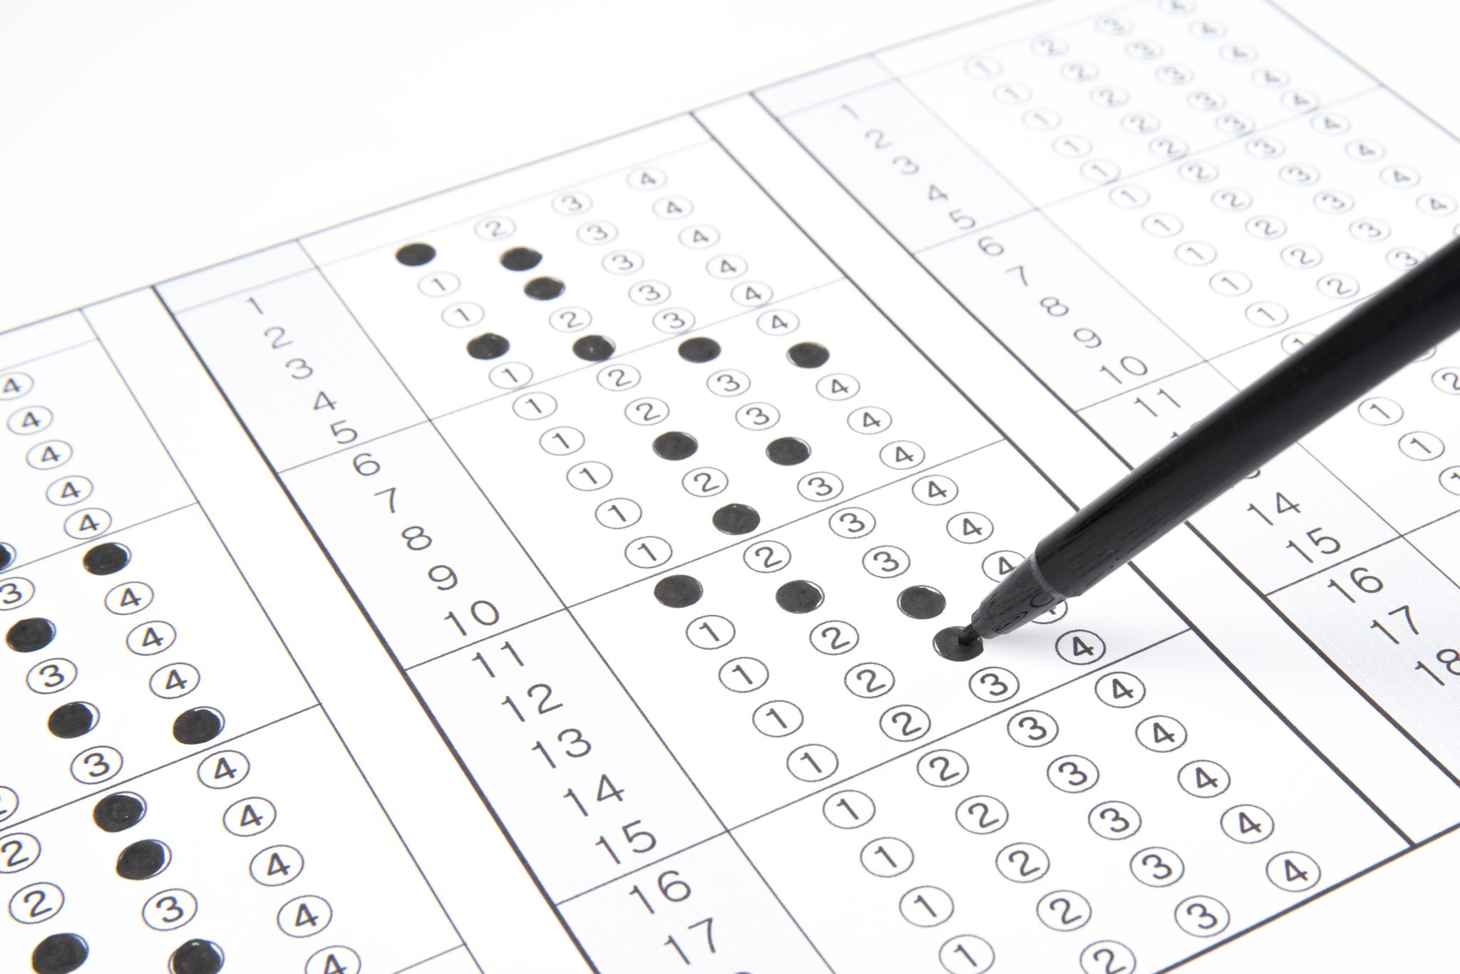
5 mins test

Slide 4
5 mins test
MÍT
ZVONIT
BOJOVAT
POTOPIT SE
JÍST

Slide 5
5 mins test
A
B
bolavý
druh
prohlížení památek
zvon
ŘÍDIT
LEŽET
návštěva
úžasný
okružní cesta
vlajkový stožár
PŘINÉST
DĚLAT, VYRÁBĚT

Slide 6
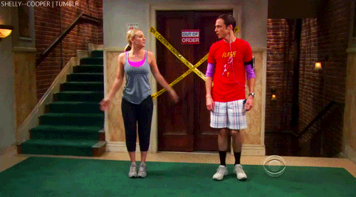
WARM-UP!
https://www.flippity.net/fc.php?k=1z63kMWGQGnkm-JcfFqaF3GquTkJiRWsHoIRk8IuYLCY

Slide 7
WORKBOOK
p. 34, ex. 3

Slide 8
ARTICLES

Slide 9
When do we use THE?

Slide 10
WORKBOOK
p. 77

Slide 11
STUDENT‘S BOOK
p. 45

Slide 12
2. Complete the sentences. Choose A or B.
I’d love to visit ____ in Paris.
The London Eye is ____ wheel of its kind in the world.
In New York lots of people go running in ____ .
Dad’s office is on ____ floor of that building.
We walked across ____ .
What was ____ part of your trip?
One day, we’ll visit ____.
Last summer, our school went on a trip to ____ in Portugal.
B. the Eiffel Tower
A. the biggest
A. Central Park
B. the second
B. Westminster Bridge
A. the best
B. Madame Tussauds
A. Lisbon

Slide 13
1. Complete the sentences with THE or -.
Its _______ tallest building in _______ London.
We saw _______ Billy Elliot on _______ Saturday.
Our _______ bus went past _______ Trafalgar Square.
They took _______ train to _______ London.
I didn’t see _______ Nelson’s Column.
We want to visit _______ London Eye.
The Queen lives at _______ Buckingham Palace.
There are lots of shops on _______ Oxford Street.
It’s THE tallest building in London.
We saw Billy Elliot on Saturday.
Our bus went past Trafalgar Square.
They took THE train to London.
I didn’t see Nelson’s Column.
We want to visit THE London Eye.
The Queen lives at Buckingham Palace.
There are lots of shops on Oxford Street.

Slide 14
HOMEWORK
vocabulary 4A

Slide 15
Lesson Plan
5 mins test
warm-up
articles
definite article - revision
definite article - practice
homework

