Slide 1
Cities
The definite article

Slide 2
Lesson Plan
warm-up
SB - story
definite article - introduction
WB – vocabulary practice
homework

Slide 3
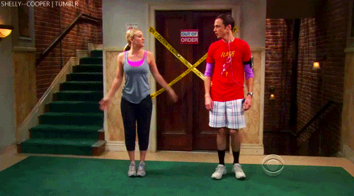
WARM-UP!
https://www.flippity.net/fc.php?k=1z63kMWGQGnkm-JcfFqaF3GquTkJiRWsHoIRk8IuYLCY

Slide 4
Name 10 famous places in London

Slide 5
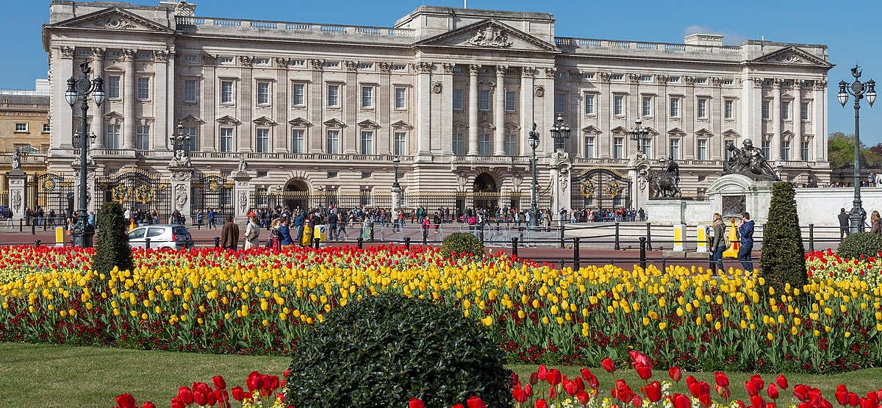
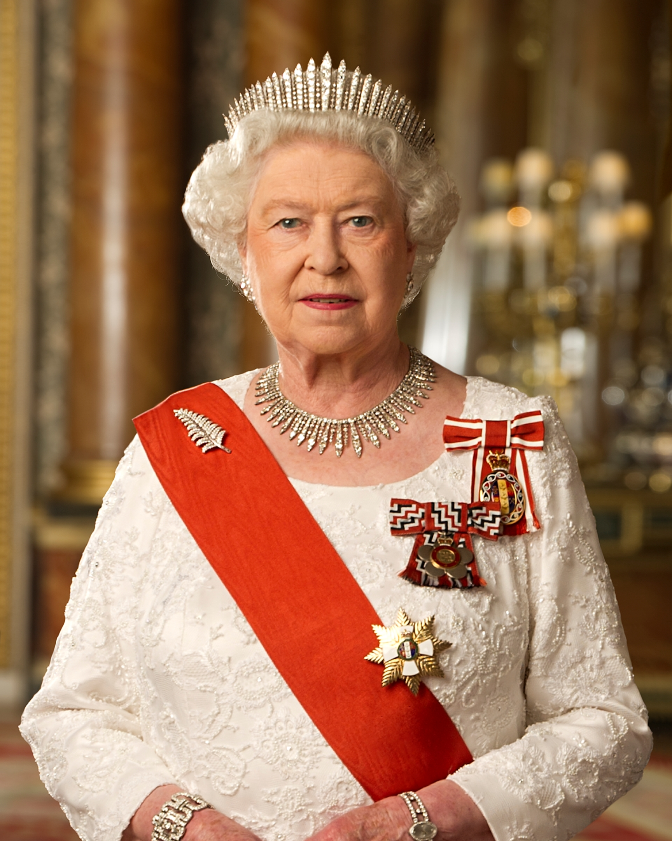
STUDENT‘S BOOK
p. 44, ex. 1

Slide 6
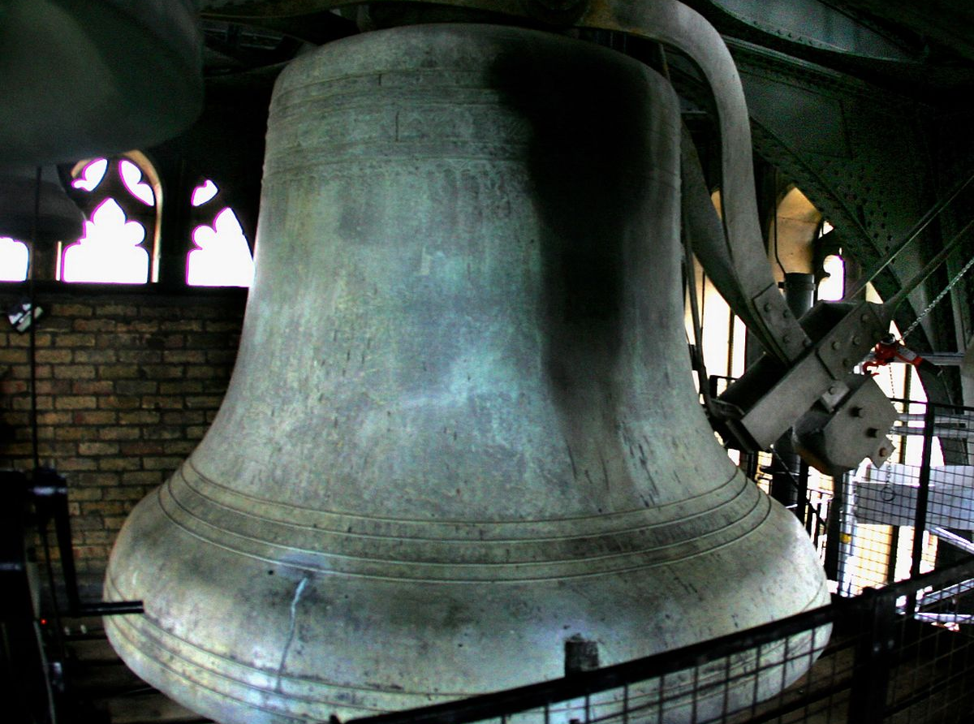
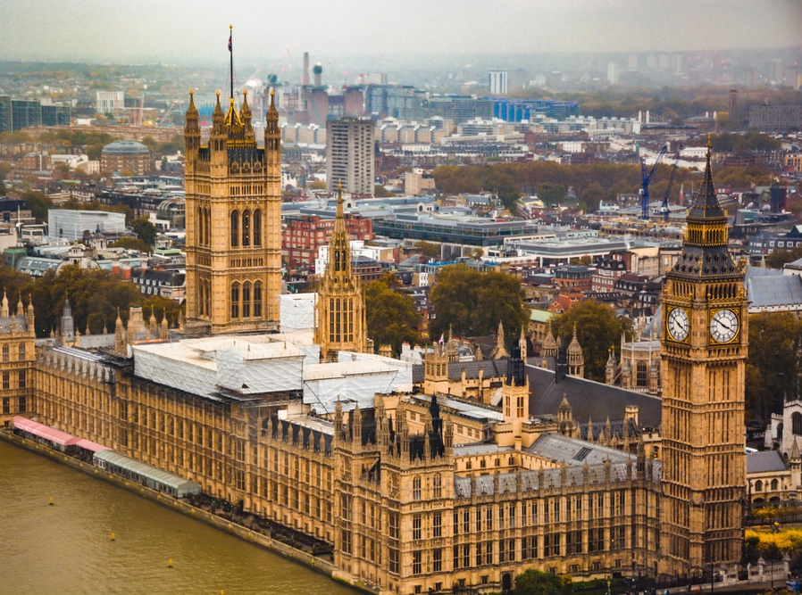
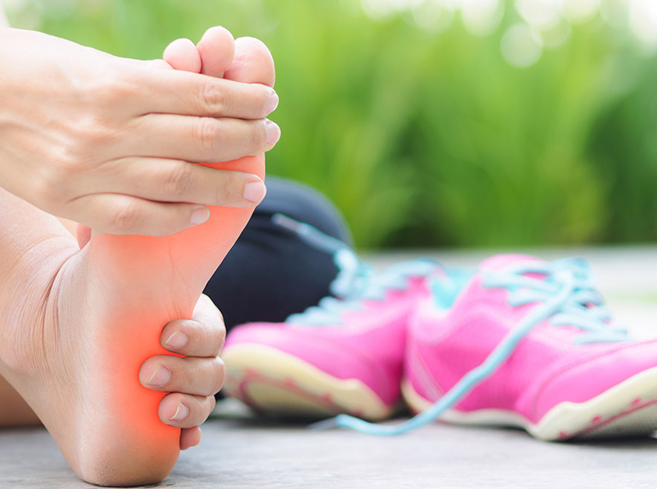
STUDENT‘S BOOK
p. 44, ex. 1

Slide 7
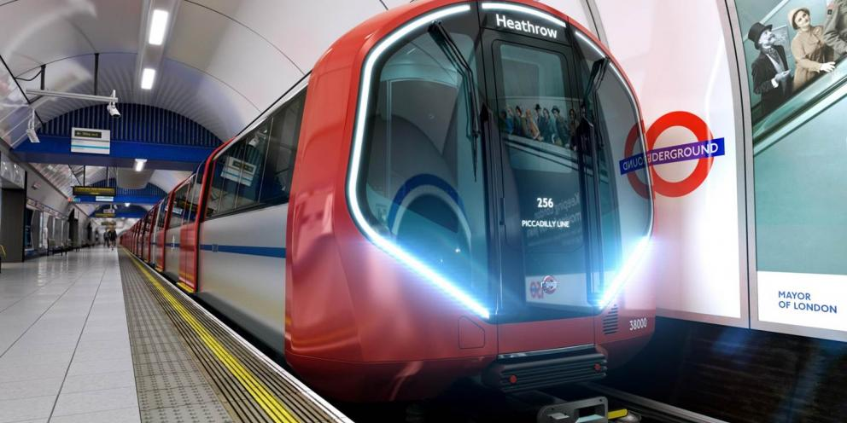
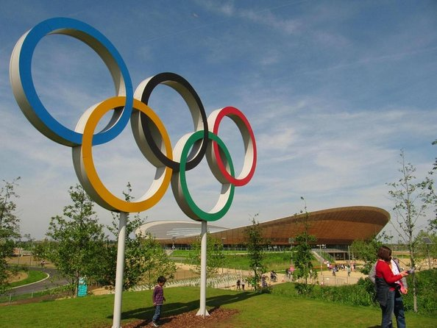
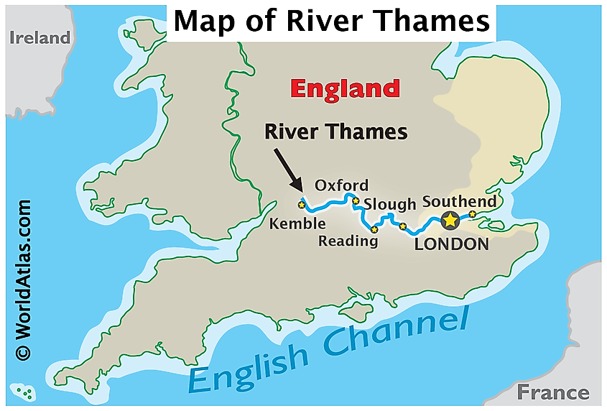
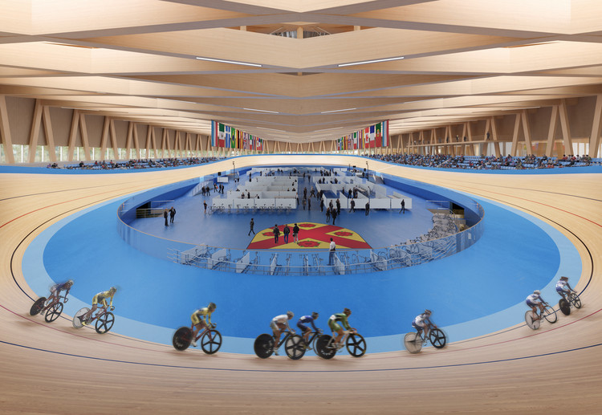
STUDENT‘S BOOK
p. 44, ex. 1

Slide 8
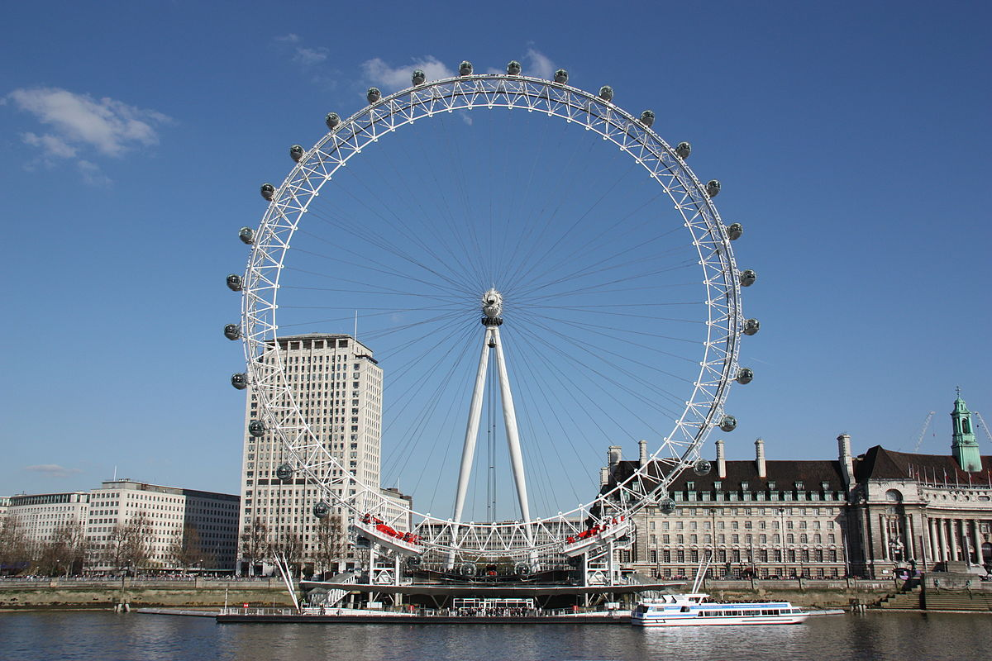
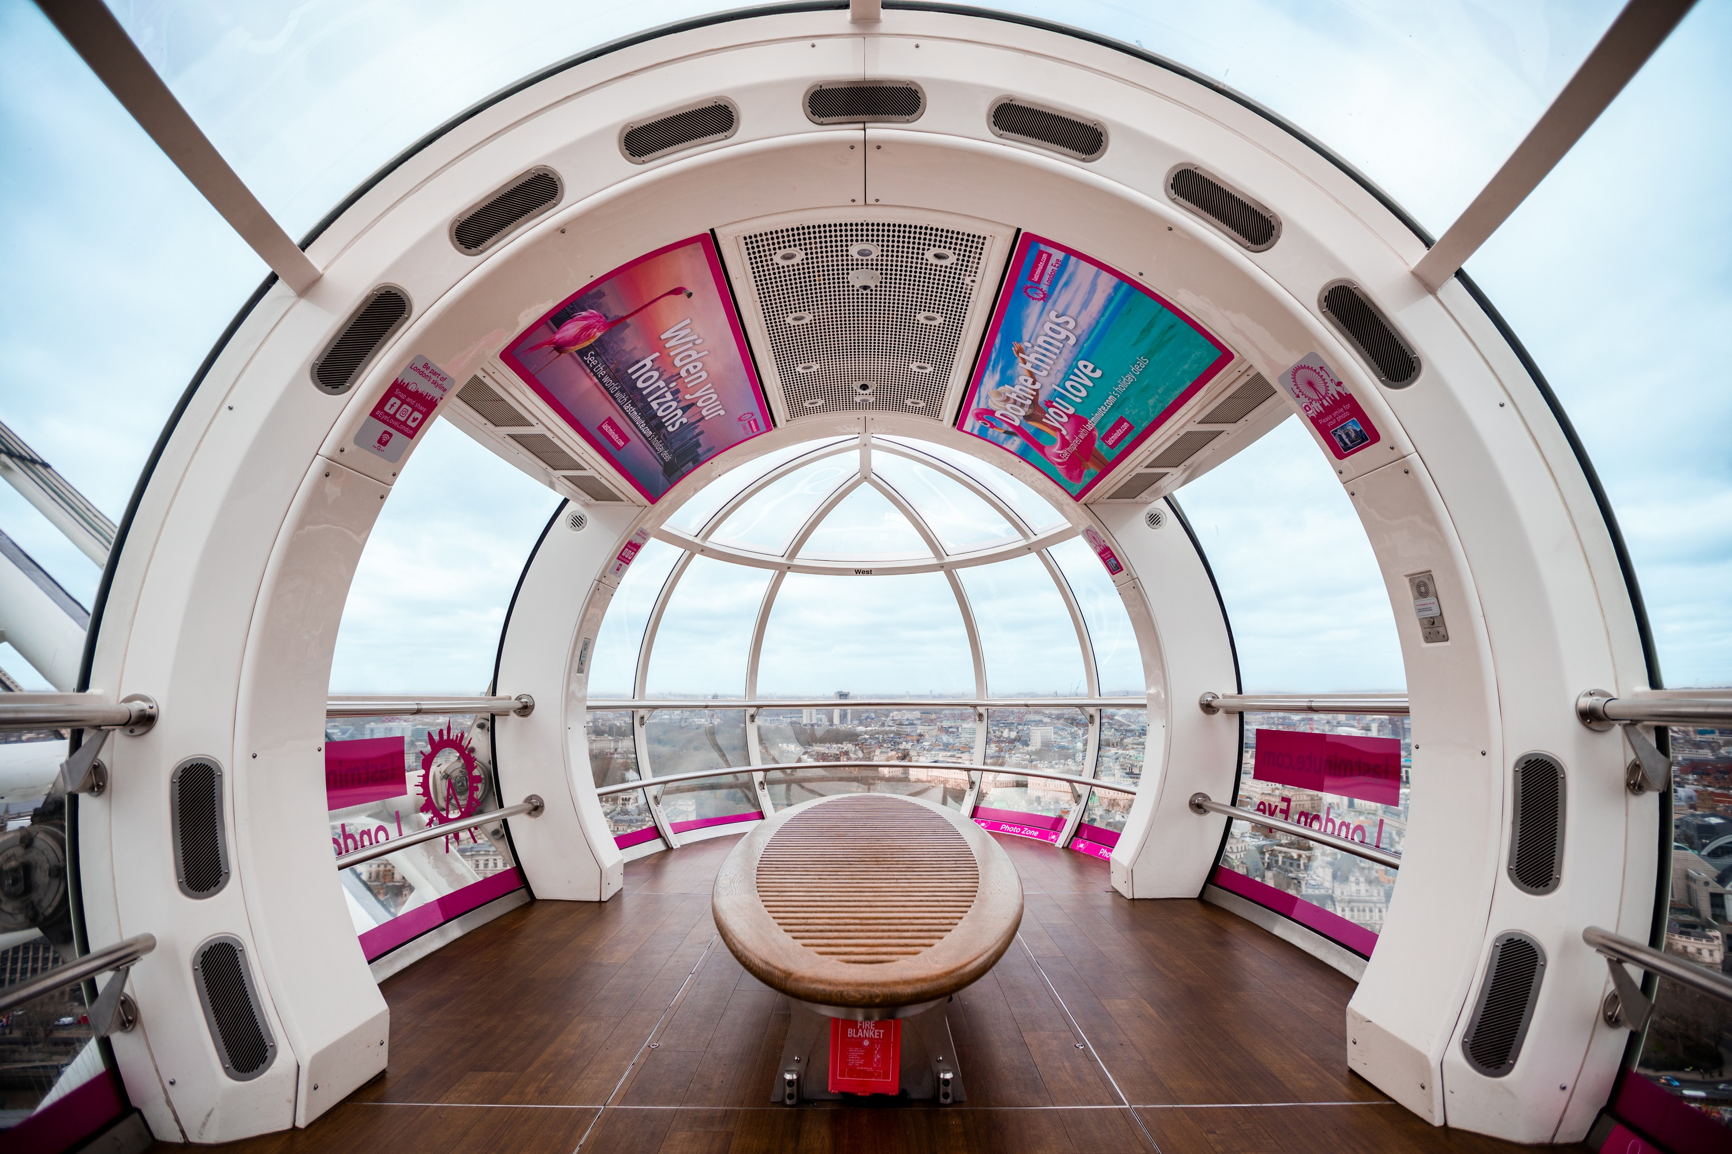
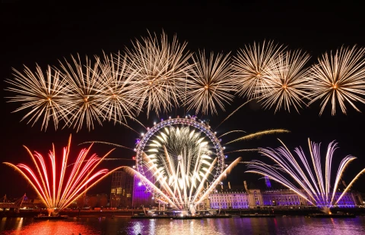
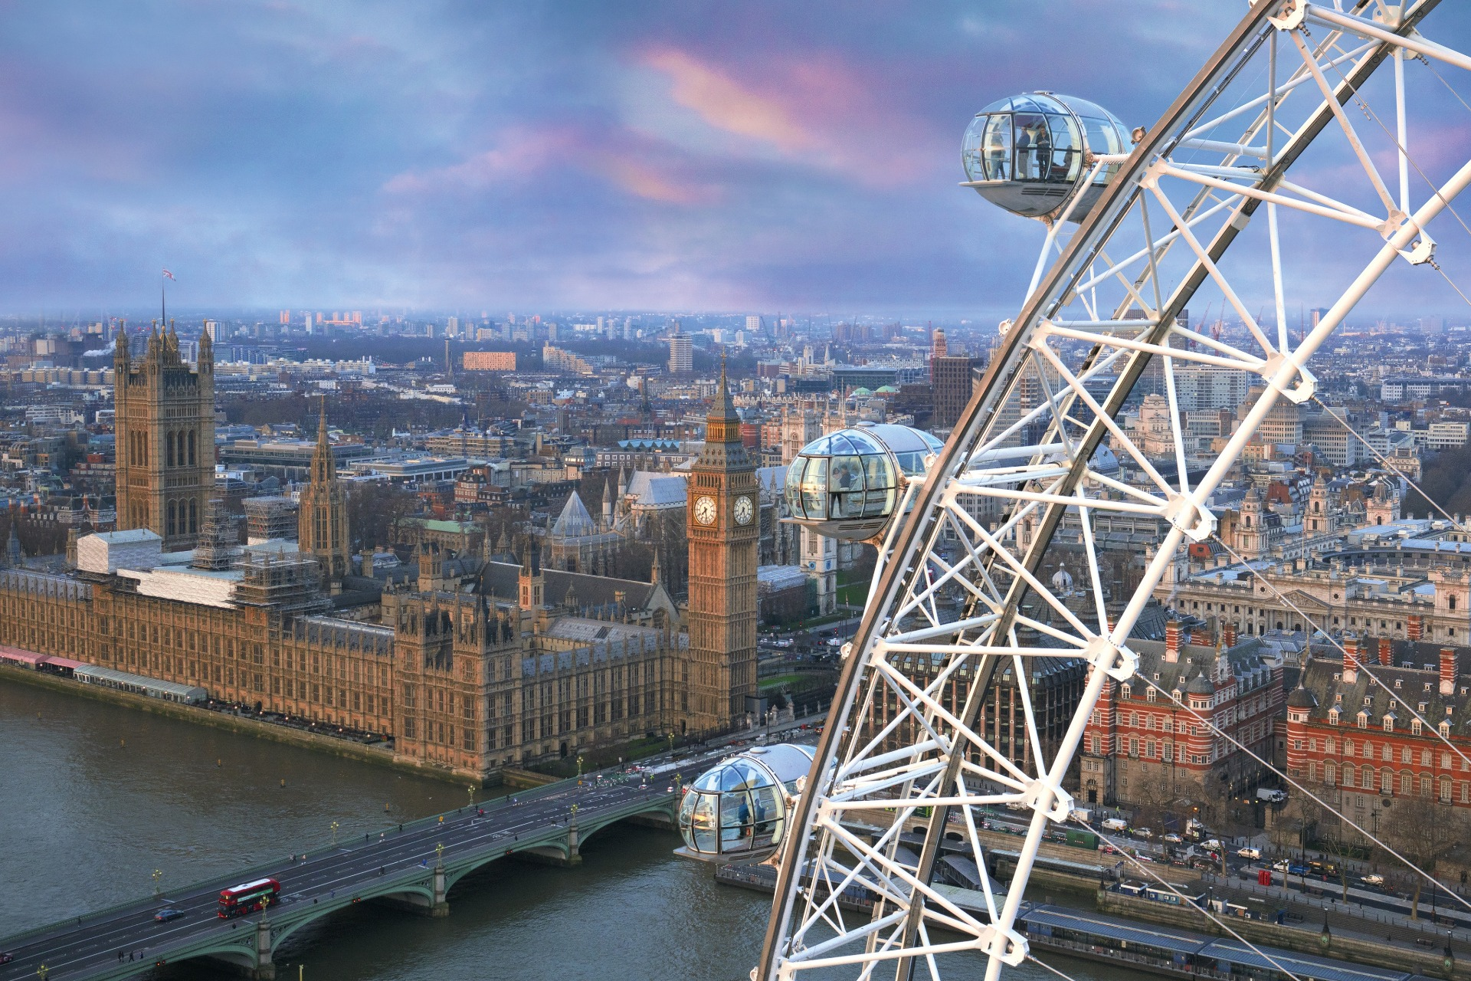
STUDENT‘S BOOK
p. 44, ex. 1

Slide 9
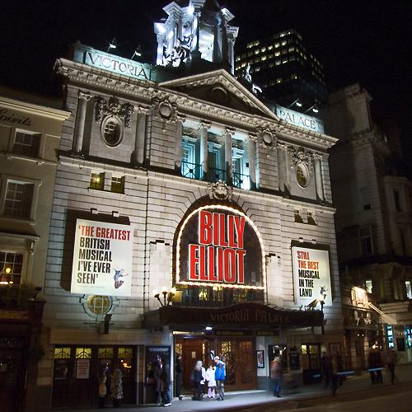
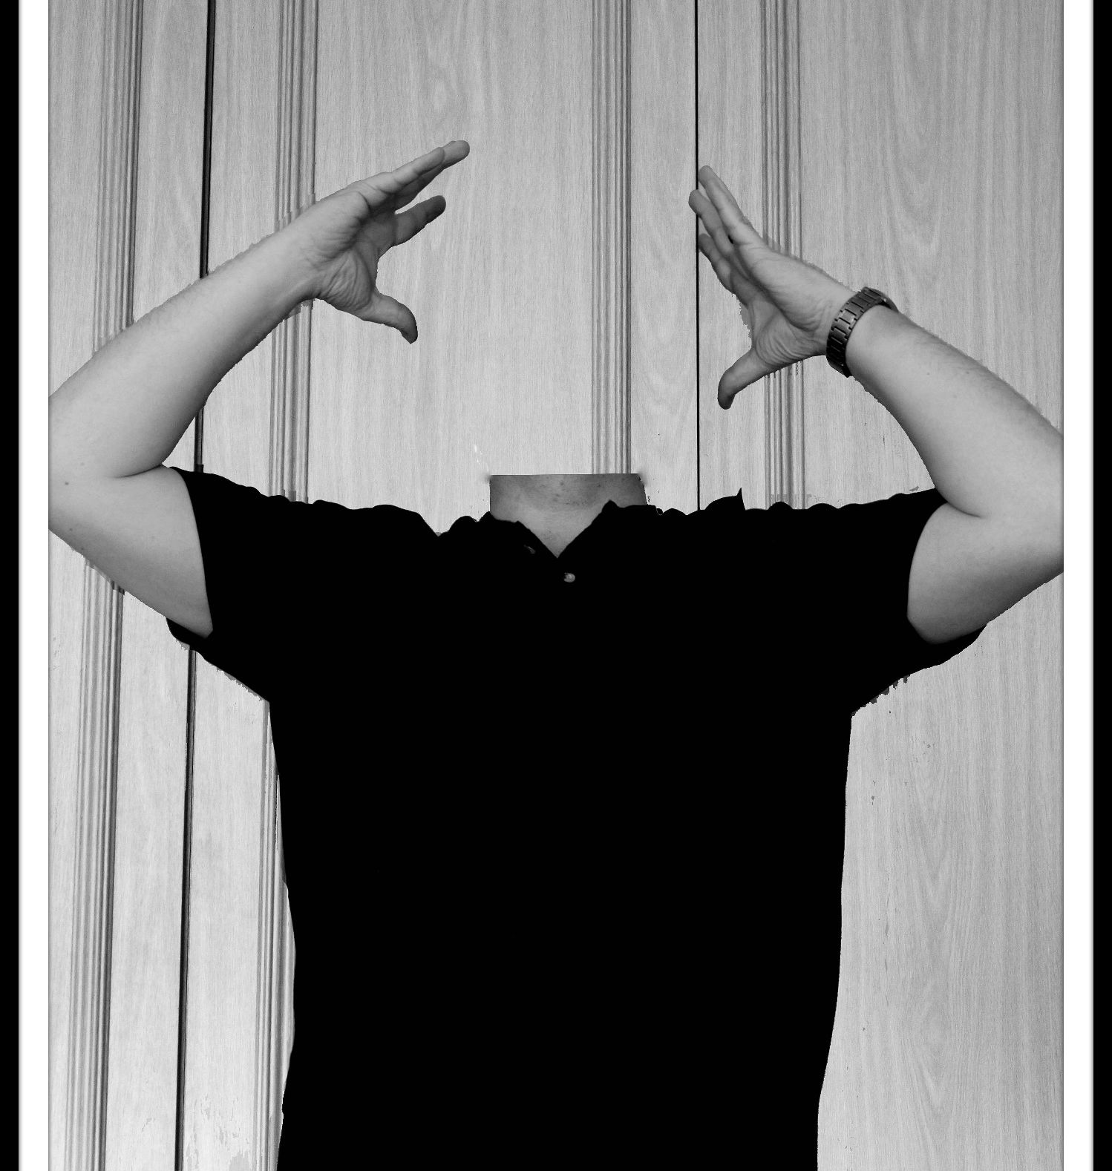
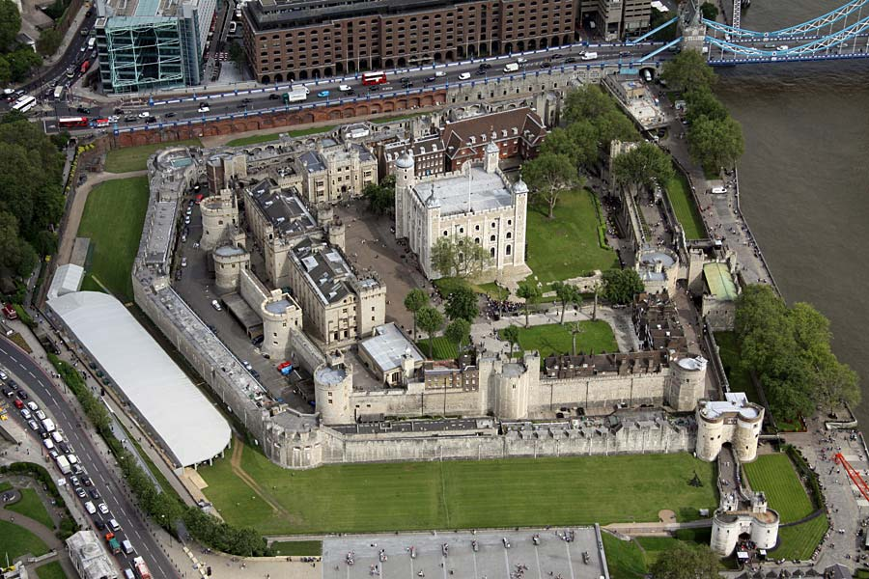
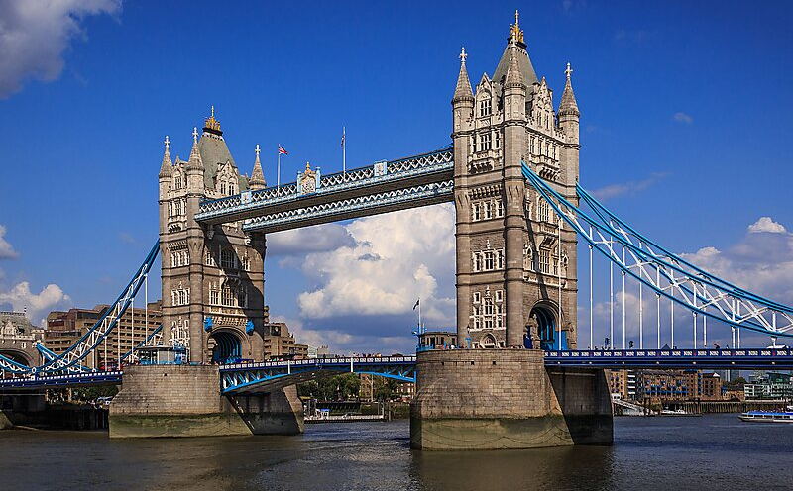
STUDENT‘S BOOK
p. 44, ex. 1

Slide 10
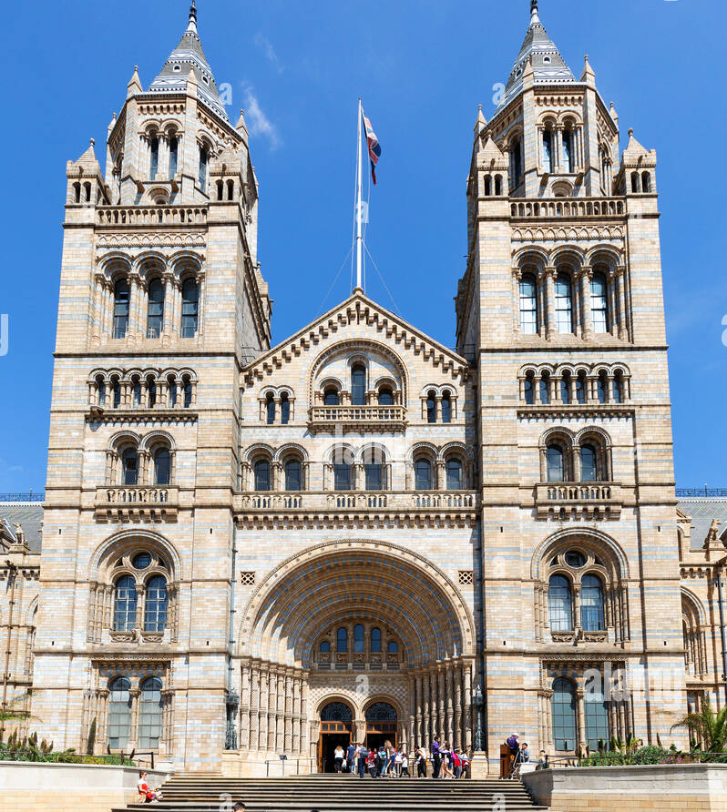
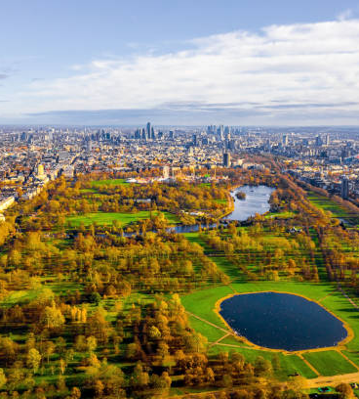
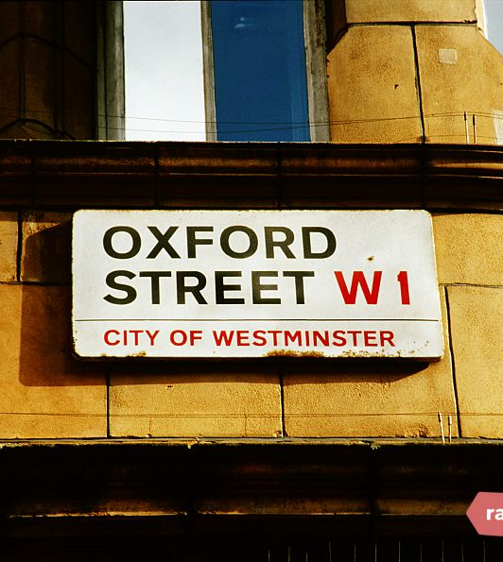
STUDENT‘S BOOK
p. 44, ex. 1

Slide 11
WORKBOOK
p. 77

Slide 12
WORKBOOK
p. 34, ex. 1, 3

Slide 13
HOMEWORK
vocabulary 4A

Slide 14
Lesson Plan
warm-up
SB - story
definite article - introduction
WB – vocabulary practice
homework

