Slide 1
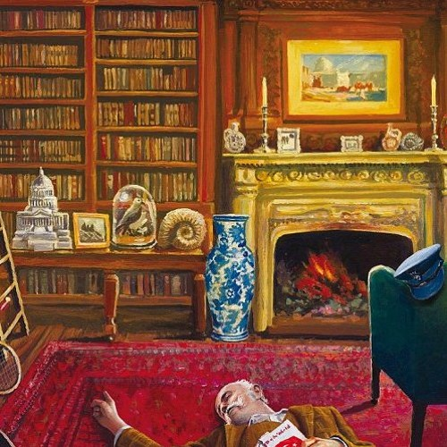
Murder in the library
Past continuous – reading and speaking

Slide 2
Lesson Plan
check your homework
warm-up
SB – story
SB – working with the story
WB – practice
homework

Slide 3
CHECK YOUR HOMEWORK!

Slide 4
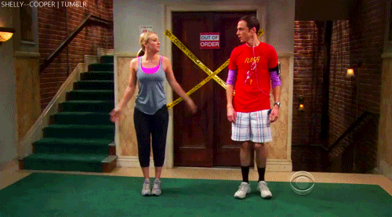
WARM-UP!
https://www.flippity.net/fc.php?k=1z63kMWGQGnkm-JcfFqaF3GquTkJiRWsHoIRk8IuYLCY

Slide 5
WORKBOOK
p. 28, ex. 2, 3

Slide 6
STUDENT‘S BOOK
p. 36 Read the text.
Find words you don‘t understand.

Slide 7
Answer the questions.
Who was John Ross?
When did he die?
Where was he when he died?
Who else was at the house at the time?
What was each person doing?

Slide 8
John Ross was a film star.
He died at 2:10 p.m.
He was in the library.
There were 4 other people. Wilson, the butler; Mrs Clare, the cook, Adams, the chauffeeur; Donna, John‘s stepdaughter
Wilson was setting the table in the dining room. Mrs Clare was peeling potatoes in the kitchen. Adams was repairing the car outside. Donna was watching television in the living room.

Slide 9
Label the picture.
THE KITCHEN
LIBRARY
THE DINING ROOM
J. ROSS
WILSON
MRS CLARE
DONNA
ADAMS
THE LIVING ROOM

Slide 10
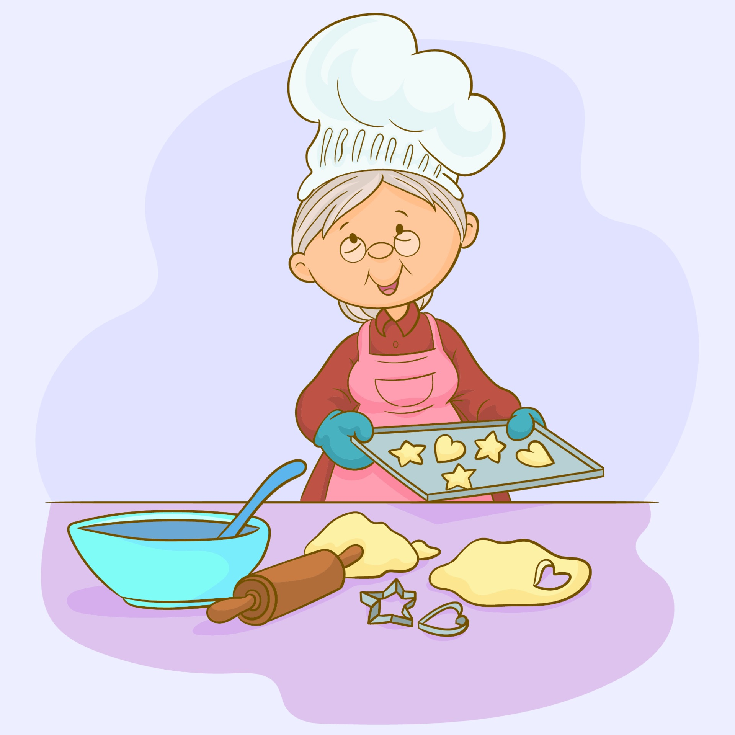
Who is the murderer?

Slide 11
STUDENT‘S BOOK
p. 37, ex. 4b) Smart Alec is interviewing Donna.
Listen and write down any important information.

Slide 12
Who is the murderer?

Slide 13
STUDENT‘S BOOK
p. 37, ex. 5b) Smart Alec knows the killer.
Listen and find out if you were right, too.

Slide 14
HOMEWORK
vocabulary 3C

Slide 15
Lesson Plan
check your homework
warm-up
SB – story
SB – working with the story
WB – practice
homework

