Slide 1
A dangerous situation
Past continuous and past simple

Slide 2
Lesson Plan
check your homework
warm-up
SB – new vocabulary
SB – interview
past continuous x past simple - introduction
WB - practice
homework

Slide 3
CHECK YOUR HOMEWORK!
were brushing our teeth.
We were taking photos.
I was putting on my coat.
I was doing my homework.
We were watching TV.

Slide 4
CHECK YOUR HOMEWORK!

Slide 5
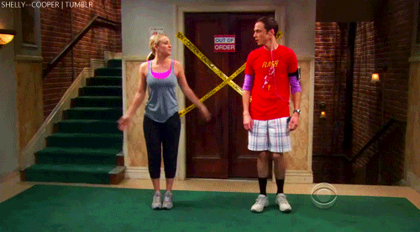
WARM-UP!
https://www.flippity.net/fc.php?k=1z63kMWGQGnkm-JcfFqaF3GquTkJiRWsHoIRk8IuYLCY

Slide 6
WORD SCRAMBLE

Slide 7
STUDENT‘S BOOK
p. 34, ex. 1a) Listen and repeat.
p. 34, ex. 2 Read and listen to the interview.
Where was John going? Why?
What did he see? What did he do?
How does he feel now? Why?
Find past simple in the text.
Find past continuous in the text.

Slide 8
PAST CONTINUOUS x PAST SIMPLE
I was reading a book
when the phone rang.
X
NOW

Slide 9
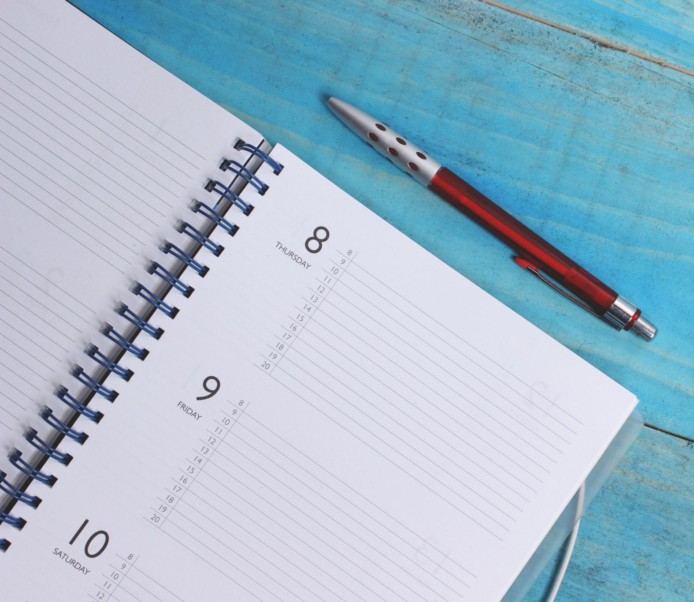
WORKBOOK
p. 27, ex. 5

Slide 10
HOMEWORK
vocabulary 3B

Slide 11
Lesson Plan
check your homework
warm-up
SB – new vocabulary
SB – interview
past continuous x past simple - introduction
WB - practice
homework

