Slide 1

Times and places
PAST CONTINUOUS

Slide 2

Lesson Plan
timetable
warm-up
SB - story
past continuous - introduction
past continuous - practice
homework

Slide 3


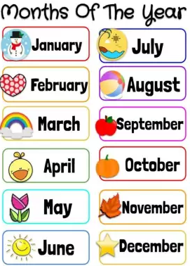
TIMETABLE

Slide 4
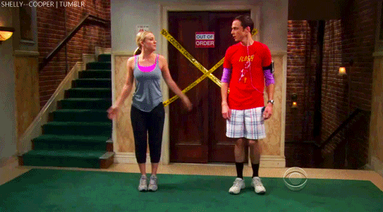
WARM-UP!
https://www.flippity.net/fc.php?k=1z63kMWGQGnkm-JcfFqaF3GquTkJiRWsHoIRk8IuYLCY

Slide 5










Name the countries …

Slide 6
STUDENT‘S BOOK
p. 32, ex. 1 Look at the map.
Tick the countries James‘s friends live in.
p. 32, ex. 2a) Read and listen.
Write the correct times in the texts.
Find words you don‘t understand.
p. 32, ex. 2b) Who is in each picture?
Match the pictures to the countries on the map.

Slide 7
PAST CONTINUOUS

Slide 8
PAST CONTINUOUS AFFIRMATIVE
I was playing computer games.
You were playing computer games.
He / She / It was playing computer games.
We were playing computer games.
They were playing computer games.

Slide 9
PAST CONTINUOUS NEGATIVE
I wasn‘t playing computer games.
You weren‘t playing computer games.
He / She / It wasn‘t playing computer games.
We weren‘t playing computer games.
They weren‘t playing computer games.

Slide 10
PAST CONTINUOUS QUESTION
Was I playing computer games?
Were you playing computer games?
Was he / she / it playing computer games?
Were we playing computer games?
Were they playing computer games?

Slide 11

WORKBOOK
p. 24, ex. 1

Slide 12

HOMEWORK
vocabulary 3A

Slide 13

Lesson Plan
timetable
warm-up
SB - story
past continuous - introduction
past continuous - practice
homework

