Slide 1
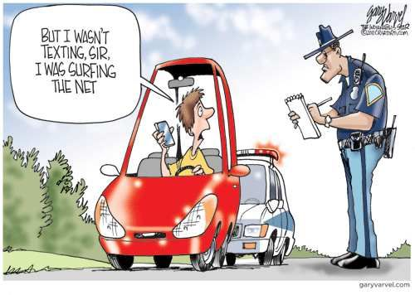
Past continuous
PRACTICE

Slide 2
Lesson Plan
5 mins test
warm-up
SB - collocations
past continuous - revision
past continuous - practice
homework

Slide 3
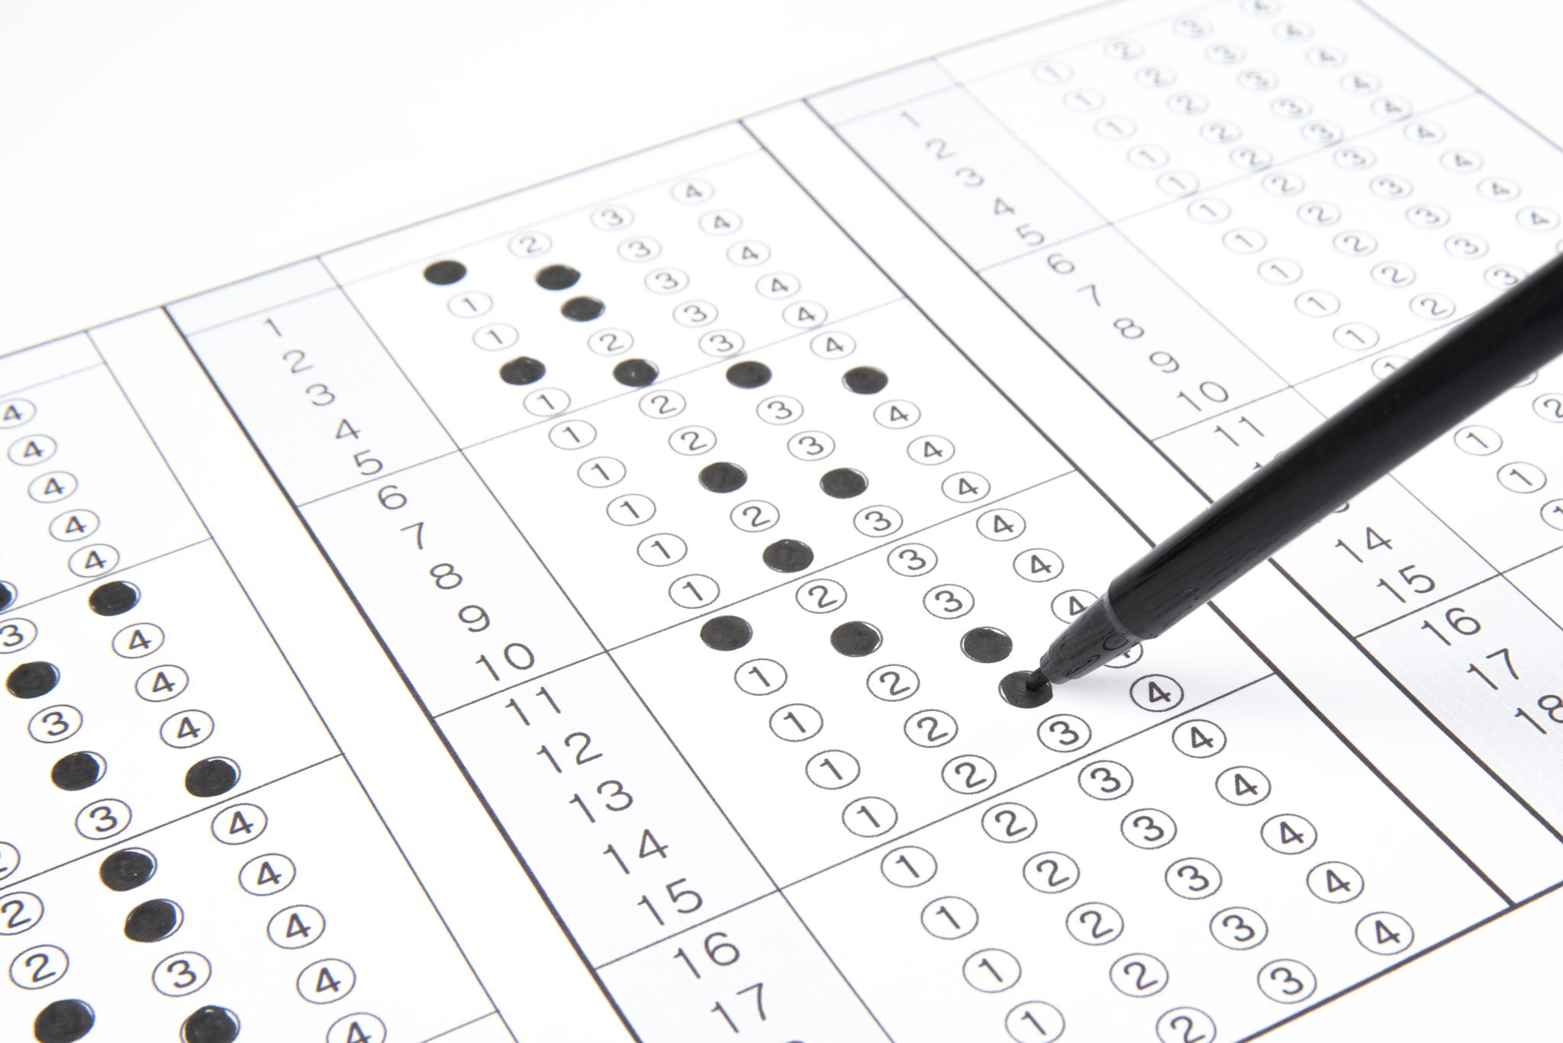
5 mins test

Slide 4
5 mins test
přestávka
připravit se
snít o
každý
KOUSAT
BOJOVAT

Slide 5
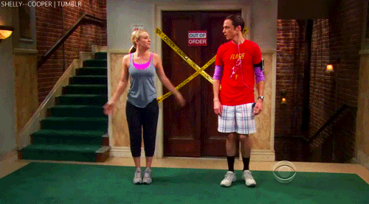
WARM-UP!
https://www.flippity.net/fc.php?k=1z63kMWGQGnkm-JcfFqaF3GquTkJiRWsHoIRk8IuYLCY

Slide 6
STUDENT‘S BOOK
p. 33, ex. 3a)

Slide 7
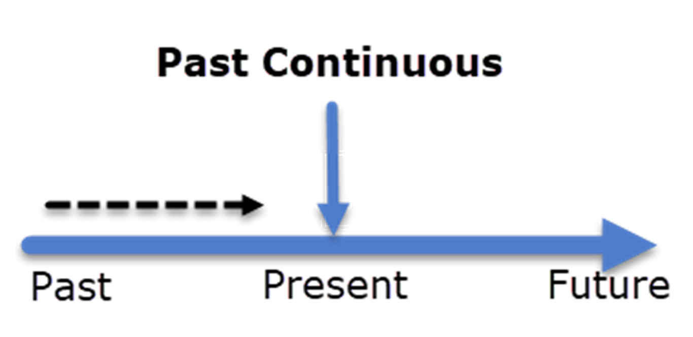
PAST CONTINUOUS

Slide 8
Unit 3 Grammar
ex. 3 – 4 sentences
ex. 2 – 4 sentences
ex. 4

Slide 9
4. Choose the correct words.
Mike wasn’t / were making a cheese sandwich.
Nina and Oscar were / was watching a film.
Betty weren’t / was washing her hair.
We wasn’t / weren’t having breakfast in a café.
The two girls were / wasn’t doing their homework.
Joe weren’t / was switching on the radio.
Rita wasn’t / were getting ready for the party.
Hamish and Miles was / weren’t walking on the beach.

Slide 10
3. Write questions with the past continuous.
what / your sister / do
where / you / go
when / the bus / leave
what / Janie / read
you / wait / a long time
where / David / sit
she / shop / at the supermarket
who / they / meet
What was your sister doing?
Where were you going?
When was the bus leaving?
What was Janie reading?
Were you waiting a long time?
Where was David sitting?
Was she shopping at the supermarket?
Who were they meeting?

Slide 11
2. Rewrite as negative sentences.
Anna was playing the guitar.
Mick and Richard were taking photos.
Dad was feeding the dog.
I was cleaning my shoes.
They were getting ready for school.
My friends were buying clothes.
Zac was reading a sports magazine.
Anna wasn't playing the guitar.
Mick and Richard weren't taking photos.
Dad wasn't feeding the dog.
I wasn't cleaning my shoes.
They weren't getting ready for school.
My friends weren't buying clothes.
Zac wasn't reading a sports magazine.

Slide 12
HOMEWORK
WORKBOOK
p. 25, ex. 4, 6
vocabulary 3b

Slide 13
Lesson Plan
5 mins test
warm-up
SB - collocations
past continuous - revision
past continuous - practice
homework

